Slide 1




EXCELSSIOR EDUCATION SOCIETY’S K. C. COLLEGE OF ENGINEERING AND MANAGEMENT STUDIES AND RESEARCH (Affiliated to the University of Mumbai) Mith Bunder Road, Near Hume Pipe, Kopri, Thane(E)-400603
Department of Computer Engineering
Academic Year 2023-24(Even Semester)

Slide 2
Index
Introduction to Topic
Need of Project
Problem Statement
Literature survey In Tabular Format
Algorithm for Project Development
Block Diagram
Flow-chart
Requirement Hardware and Software
Feasibility Study
Proposed Methodology
Detail Design DFD Diagram
Activity Diagram
Screenshots of GUI
Database
References
Certificates

Slide 3
Introduction to Topic
In the dynamic landscape of modern organizations, the effective management of human resources is paramount to achieving strategic goals and maintaining a competitive edge. The Enhanced E-HR System emerges as a comprehensive solution, seamlessly integrating technology and human resource management practices to streamline processes, enhance efficiency, and foster a more strategic approach to workforce management.
The Enhanced E-HR system serves as the central hub for all HR-related activities within an organization, providing a robust platform for managing employee information, recruitment, performance appraisal, training, and more. This system not only automates routine HR tasks but also empowers HR professionals with valuable insights through analytics, aiding in informed decision-making.
In this digital age, Enhanced E-HR System With the advent of technology The HRMS consolidates and centralizes employee data, providing a secure and accessible repository for personal details, qualifications, and performance records.
Facilitating employee development, it aids in planning, implementing, and tracking training programs to enhance skills and knowledge.
As organizations continue to recognize the strategic importance of their human capital, it emerges as a critical tool in fostering a positive employee experience, ensuring compliance with regulations, and driving organizational success. This introduction sets the stage for exploring the various dimensions and functionalities of the Enhanced E-HR System, ultimately contributing to the evolution of modern HR practices within the organization.

Slide 4
Need of Project
The need for a Human Resources (HR) Management System stems from the growing complexity of modern organizations and the crucial role HR plays in managing human capital effectively. Here are some key points highlighting the necessity of such a system:
A Human Resources (HR) Management System serves as a centralized hub for employee information, automating administrative tasks and enabling data-driven decision-making. By ensuring compliance with evolving regulations and streamlining processes like payroll and leave management, it empowers HR professionals to focus on strategic initiatives. Through intuitive self-service portals and enhanced communication channels, it fosters employee engagement and collaboration while adapting to organizational growth and complexity. In essence, it's a vital tool for modern businesses to optimize HR operations, promote transparency, and drive sustainable success through effective talent management
Centralized Data Management: A Enhanced E-HR System provides a centralized platform to store and manage employee information such as personal details, job history, performance evaluations, training records, and benefits. This centralized database ensures data integrity, security, and accessibility.
Streamlined Processes: Traditional paper-based HR processes can be time-consuming, error-prone, and inefficient. An Enhanced E-HR System automates routine administrative tasks such as payroll processing, leave management, and employee onboarding, thereby freeing up HR personnel to focus on strategic initiatives.

Slide 5
Problem Statement
Inefficient and disjointed human resources (HR) management processes within our organization hinder productivity, compliance, and employee engagement. Manual handling of tasks such as employee data management, payroll processing, leave tracking, and performance evaluations results in errors, delays, and suboptimal decision-making. Lack of a centralized Enhanced E-HR System leads to data fragmentation, compliance risks, and difficulty in accessing real-time insights for strategic workforce planning. Moreover, the absence of streamlined communication channels and self-service options undermines employee satisfaction and engagement levels. To address these challenges and enhance organizational efficiency, there is a critical need for the implementation of a comprehensive Enhanced E-HR System that integrates seamlessly with existing workflows, ensures regulatory compliance, empowers employees, and enables data-driven decision-making processes.

Slide 6
Literature survey In Tabular Format
Year | Associated Person/People | State of the System
1982 | Walker A.J. | HRIS development: Project team guide to build effective personnel information system
1984 | Beer et al | Defined HRM as those involved in complex decision.
1999 | Robert b. | Calculating return on investment on HR
2005 | Hufelid, M.A | Becker work force of cord card management Human capital to execute strategy
2006 | Behuselid | Strategic HR management, from journal of management
Notes:
2006 Behuselid Strategic HR management, where do we go from here, from journal of management 2005 Hufelid, m.a, Becker Work force of core card management Human capital to execute strategy
1999 Robert b. Calculating return on investment on HR.
1982 Walker A.J. HRIS development: A project team guide to building an effective personnel information system.

Slide 7
Algorithm for Project Development
1.Project Initiation: a. Define project Objectives: Create a Enhanced E-HR System which helps to maintain records of employee and improve communication.
b. Provide performance reviews as well as track record of hours attended by employee
c. Access resources and timeline feasibility
2. Planning and Design :
a. Design the UI architecture for Admin, HR, Manager and Employee
b. Create a database to maintain all the records and information
c. Make a connection between all the different profiles
3. Development:
a. Build different profiles and features regarding each profile
b. Code in order for these profiles to interact.
c. Implement for each profile to send, receive or update data accordingly
4. Testing:
a. Test the app for functionality, user-friendliness and performance
b. Address and fix any identified issues

Slide 8
Algorithm for Project Development
5. Development: a. Develop the program in order for it to receive, store or update data.
b. Make improvements based on user suggestions.
7. Documentation:
a. Documentation app architecture, design decisions and key features. b. Create instructions for user to easily operate.
8. Project Closure:
a. Verify project completion and compliance with standards. b. Archive project data and records.
9. Post- Project Review:
a. Evaluate project performance against objectives.
b. Identify areas for improvement and lessons learned.

Slide 9
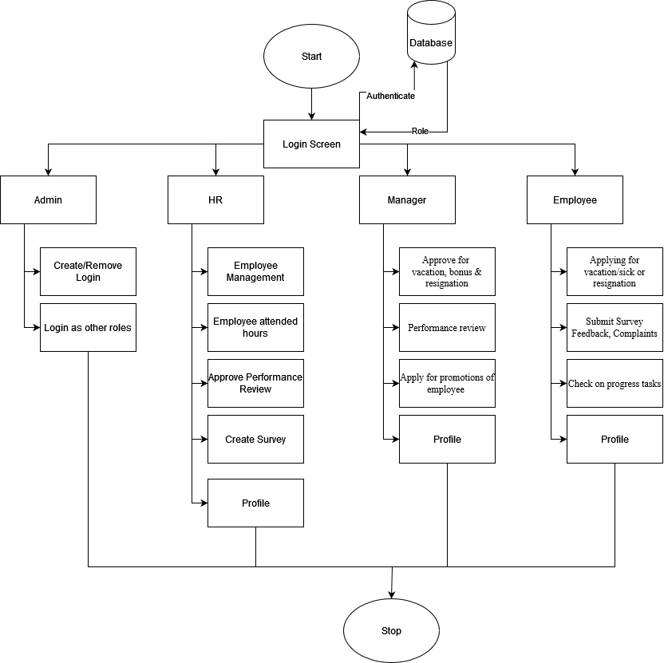
Block Diagram

Slide 10
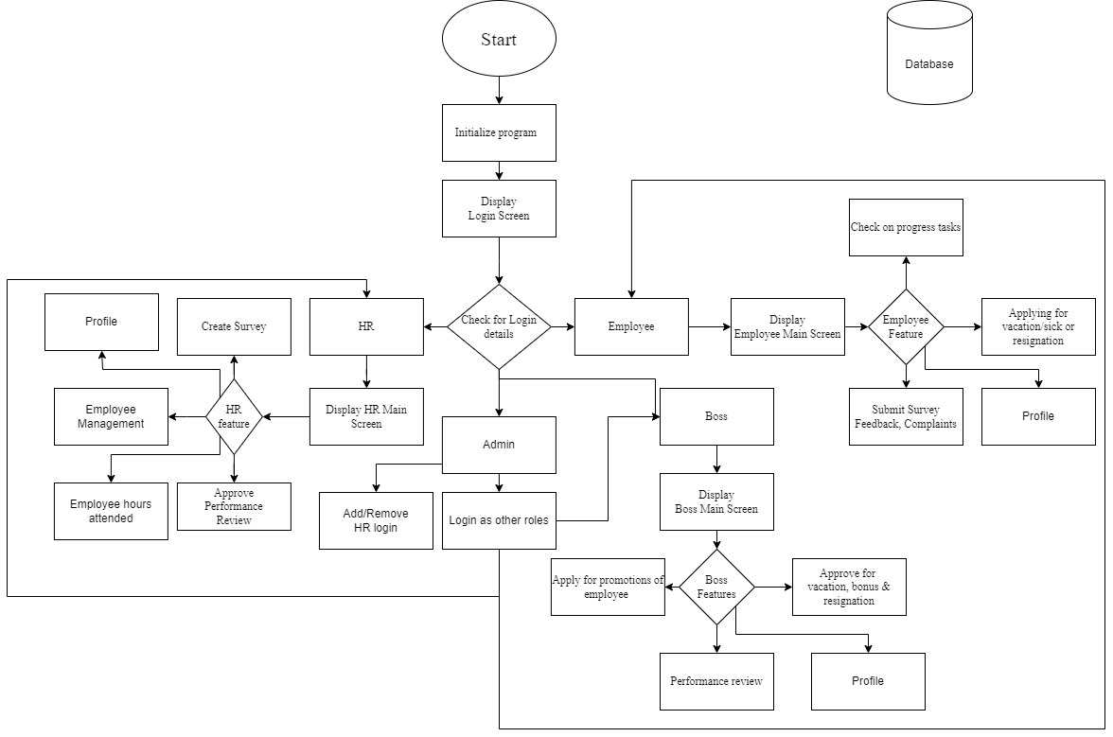
Flow-chart

Slide 11
Requirement Hardware and Software
Hardware :-
Minimum Requirements:
Processor:- Dual core processor @2.4Ghz
Ram:- 4GB Ram
Storage:- 2GB free space
Internet:- speed: 3mbps
Recommended Requirements:
Processor:- Quad core processor @2.8Ghz
Ram:- 8GB Ram
Storage:- 4GB free space
Internet: speed: 6mbps
Software :-
Minimum Requirements:
OS: Windows 10 22H2
Python: Version 3.11 with pil, firebase, firebase_admin and tkcalendar modules installed
Recommended Requirements:
OS: Windows 11 22H2
Python: Version 3.12.3 with pil, firebase, firebase_admin and tkcalendar modules installed
Notes:
Need as follows: 1. All Modules of Python should be installed 2. Path of python should be specified 3. OS 10 is required 4. Internet access required

Slide 12
Feasibility Study
Technical Feasibility:
Python latest module required.
Internet access required.
2. Economic Feasibility:
Development costs are manageable within the allocated budget.
Firebase is cost efficient database to use.
3. Operational Feasibility:
The project aligns with the organization's capabilities and resources.
Integration into existing operations is feasible.
4. Legal and Regulatory Feasibility:
No significant legal barriers are foreseen, and compliance.
5. Scheduling and Time Feasibility:
Project timelines allow for timely development and deployment.
Notes:
a. Python latest module required b. Internet access required

Slide 13
Proposed Methodology
1. User Interface: -
a. Intuitive design for employee self-service and admin dashboards.
b. Responsive and user-friendly interface.
2. Database Management: -
a. Centralized database for secure storage of employee data.
b. Database management system for efficient data retrieval.
3. Application Logic: -
a. Employee Onboarding: Digital forms and document submission.
b. Attendance Tracking & Performance Records
c. Performance Management: Goal setting, feedback mechanisms.
d. Employee Self-Service: Leave requests and personal information.
4. Technologies Used: -
a. Frontend: Python
b. Backend: Python
c. Database: Firebase

Slide 14
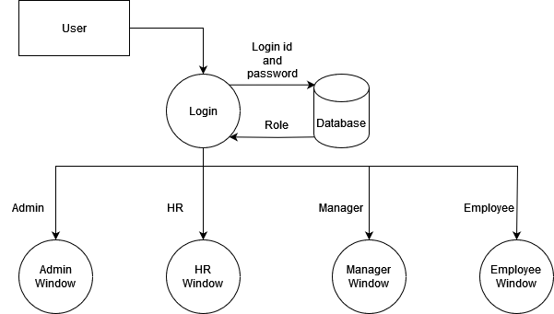
Data Flow Diagram Level 0

Slide 15
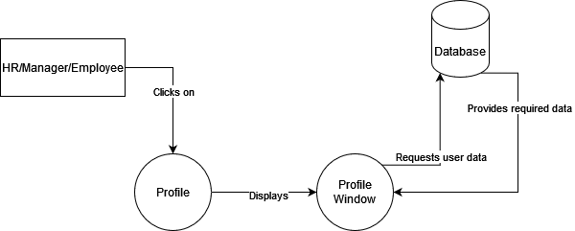
Data Flow Diagram Level 1

Slide 16
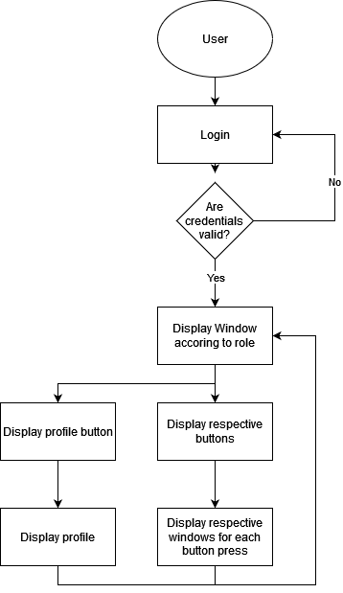
Activity Diagram

Slide 17
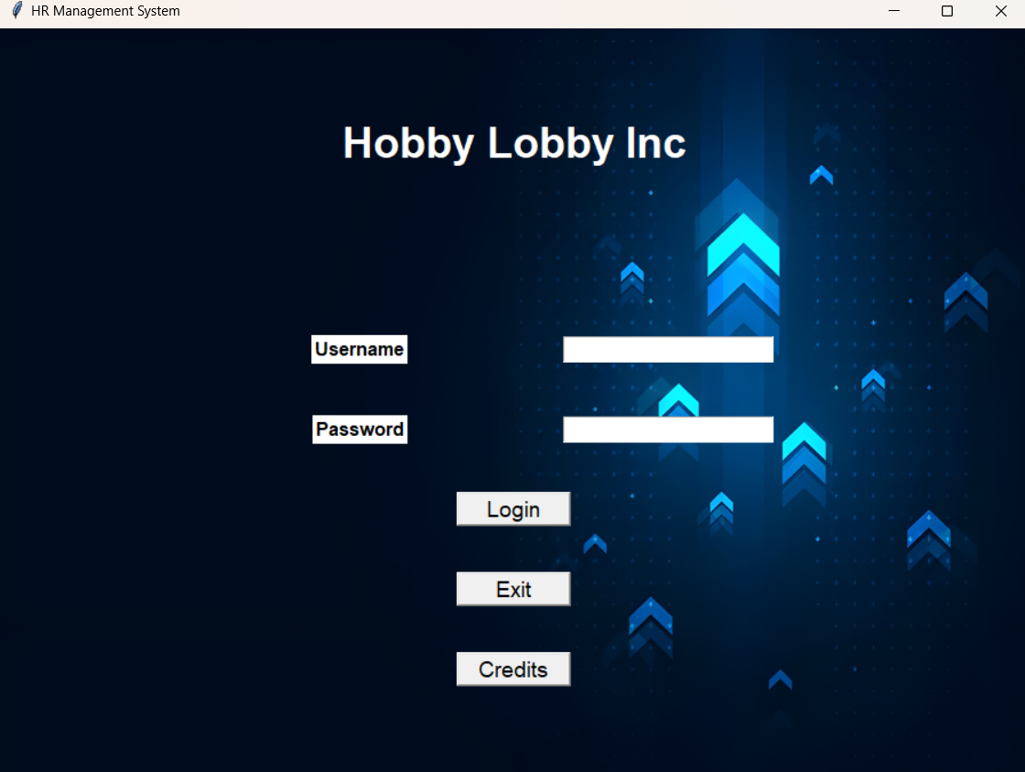
Implementation Details/ Screenshots of GUI
Main Login:
The first page presented to the user upon opening the application, this page gives the input boxes to enter the username and password along with the login button and the exit and credit buttons.
There are 4 types of windows which will open following the user’s login depending on what role has been assigned the user in the DB, the 4 types of logins are Admin (figure 3), HR (figure 8), Manager (figure 27) and Employee (figure 41).
Figure 1

Slide 18
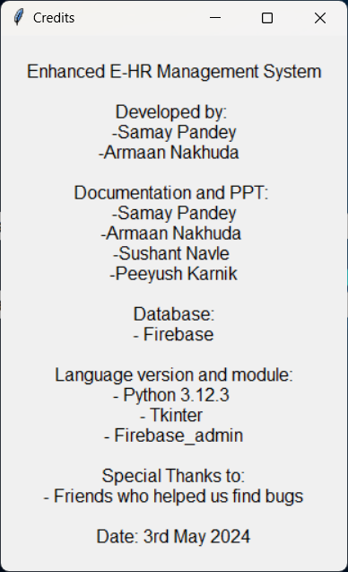
Credits Dialog box in main login screen: -
The Credits dialog which opens after clicking the credits button on the main login page.
Figure 2

Slide 19
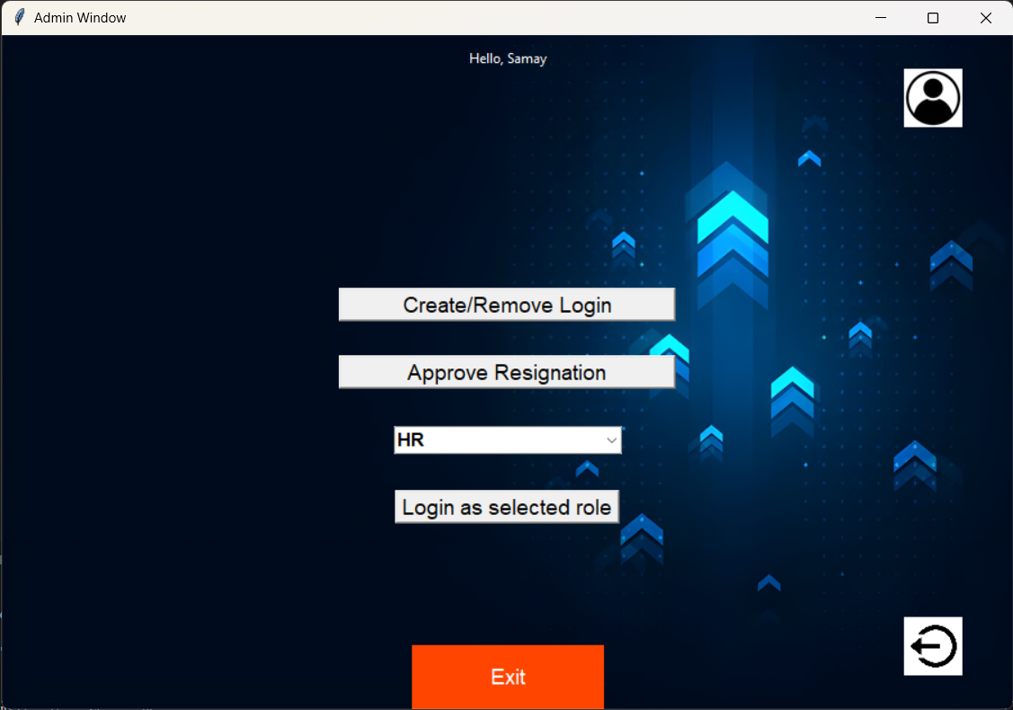
Admin Window: -
This is the main admin window first presented to the user when they first login. It contains 3 main buttons which are Create/Remove Login (figure 4) which gives the admin the option to add or remove logins of HR, Manager or Employee, the Approve Resignation button (figure 6) which approves the resignation for the HR and the Login as Selected Role button which gives the admin the option to simulate a different login level to test out issues in the application or the database. The page also contains the profile button (figure 7) which shows the details of the admin and the logout button which takes the user back to the login page (figure 1).
Figure 3

Slide 20
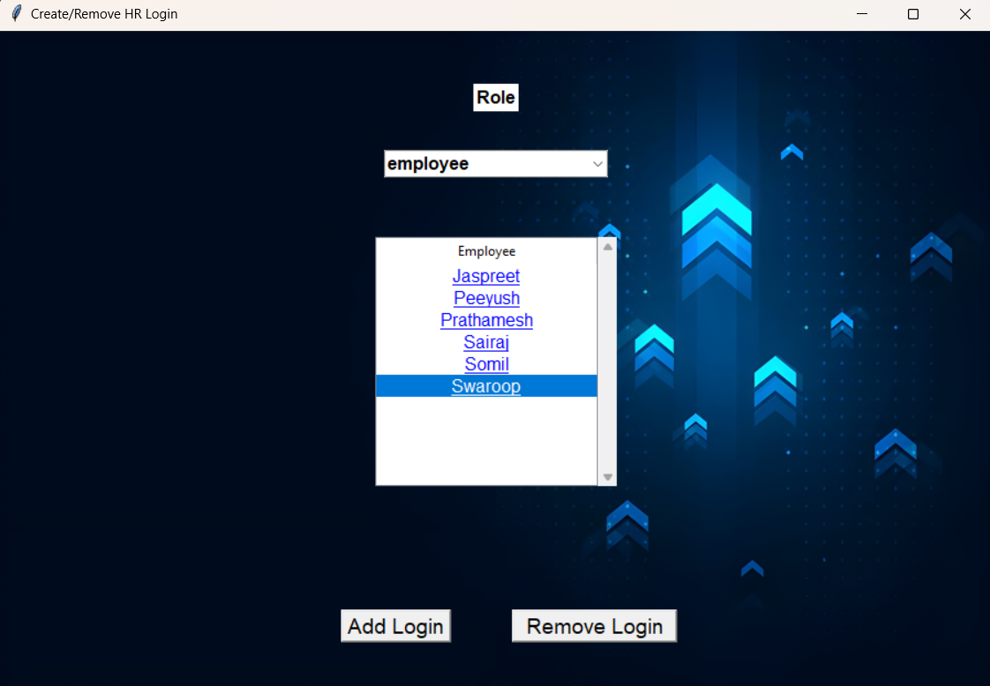
Create/Remove Login: -
The first screen that is displayed to the user when the Create/Remove button is pressed, this screen gives the admin the option to select the category of role so the logins of that role are shown, upon it being shown the admin can select one role and delete it.
Clicking the Add login button, opens a new window to enter the new login details.
Figure 4

Slide 21
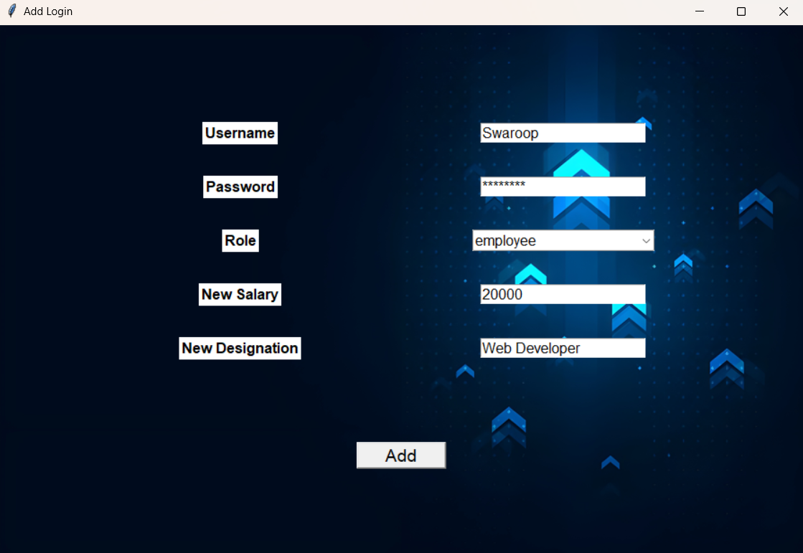
Shows the window to provide details for the new login to be added to the DB.
Figure 5

Slide 22
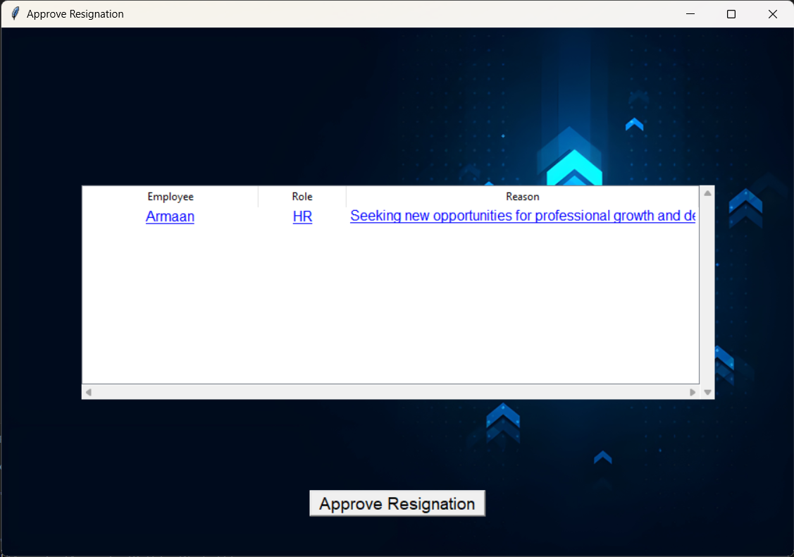
Approve Resignation: -
Here the admin role can approve for the resignation of a particular HR profile. It can review the details from the particular HR personnel such as their name and reason regarding their resignation.
Figure 6

Slide 23
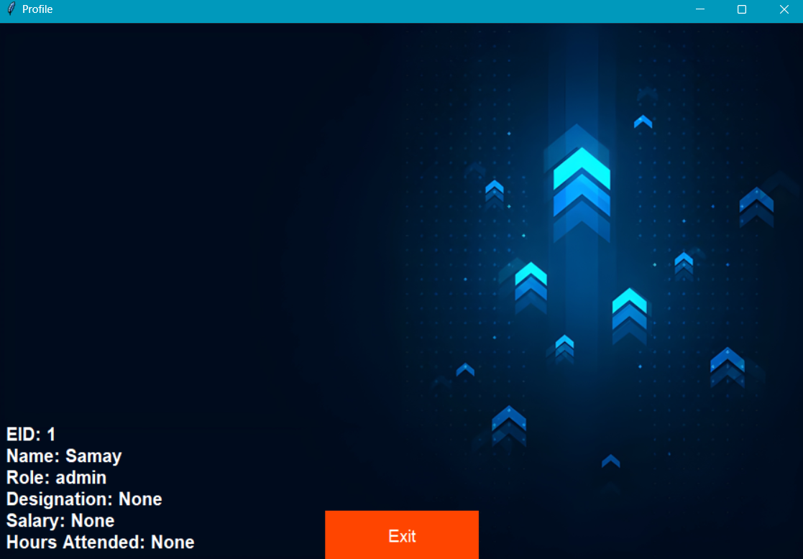
Profile for Admin: -
This Profile screen represents the details for the admin which shows the Name, EID, Role, Designation, Salary, Hours Attended, Bonus and Sick days leave/ Vacation days leave.
Figure 7

Slide 24
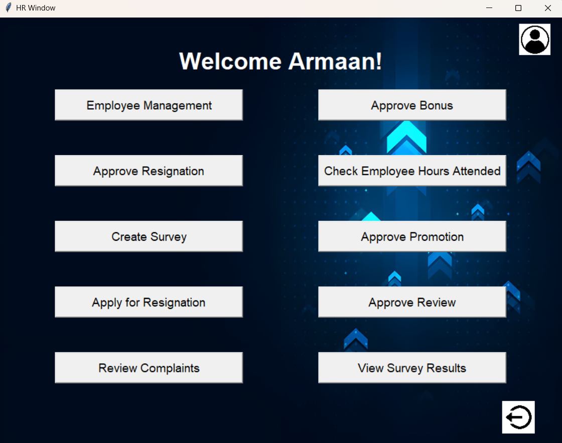
HR Window: -
The first screen shown to the HR when the user logs in, it has buttons like employee management (figure 9) to manage Managers and Employees, Approve bonus to employees and grant bonus to managers (figure 13), approve resignations for Managers and employees (figure 16), check employee hours and warn them if their hours are low compared to what it should be (figure 17), send out survey with specified questions to the employees to be filled (figure 18), approve for promotion of employee (Figure 19), Apply for resignation (figure 20), Approve review for the employees and managers (figure 21), review complaints against employees (figure 23) and view the survey answers sent in by the employees (figure 24). The screen also has a profile button to view the details (figure 26) and a logout button which will take the user back to the login screen (figure 1).
Figure 8

Slide 25
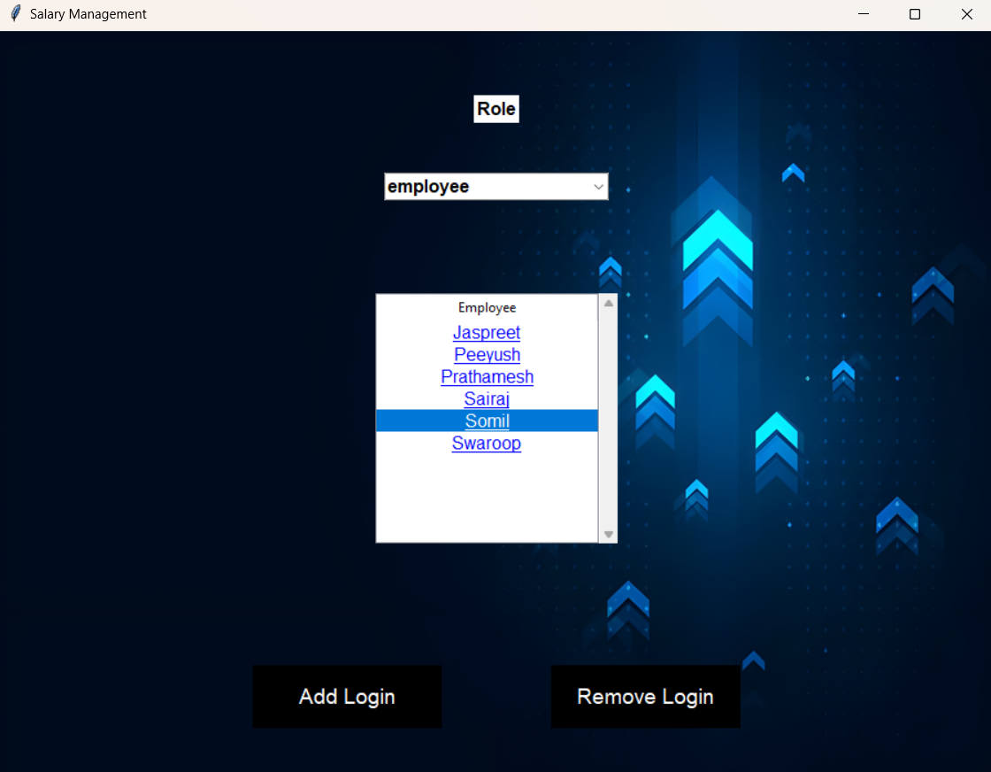
Employee Management: -
When the Employee Management button is clicked, this window will appear to the user which includes a toggle to select the role between manager and employee, upon selecting the role all the logins within that role will show up in the list below, the user can then click on any name to show the details of the employee as shown in figure 10.
The add login button will open a new window which allows to input the details for the new login as shown in figure 5.
The remove login button will remove the selected login.
Figure 9

Slide 26
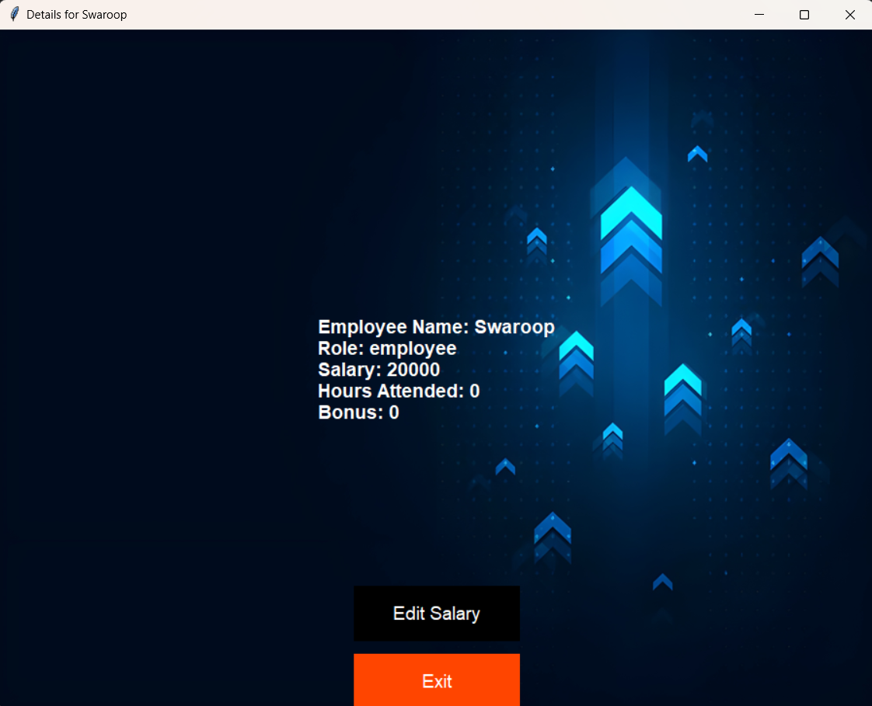
The details of the employee that was clicked is shown in a new window, along with the option to edit the salary for the employee.
Figure 10

Slide 27
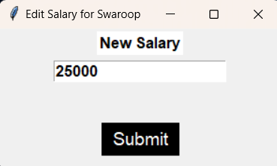
When the user clicks on edit salary button a new window will open asking for the input for the new salary of the Manager/Employee.
Figure 11

Slide 28
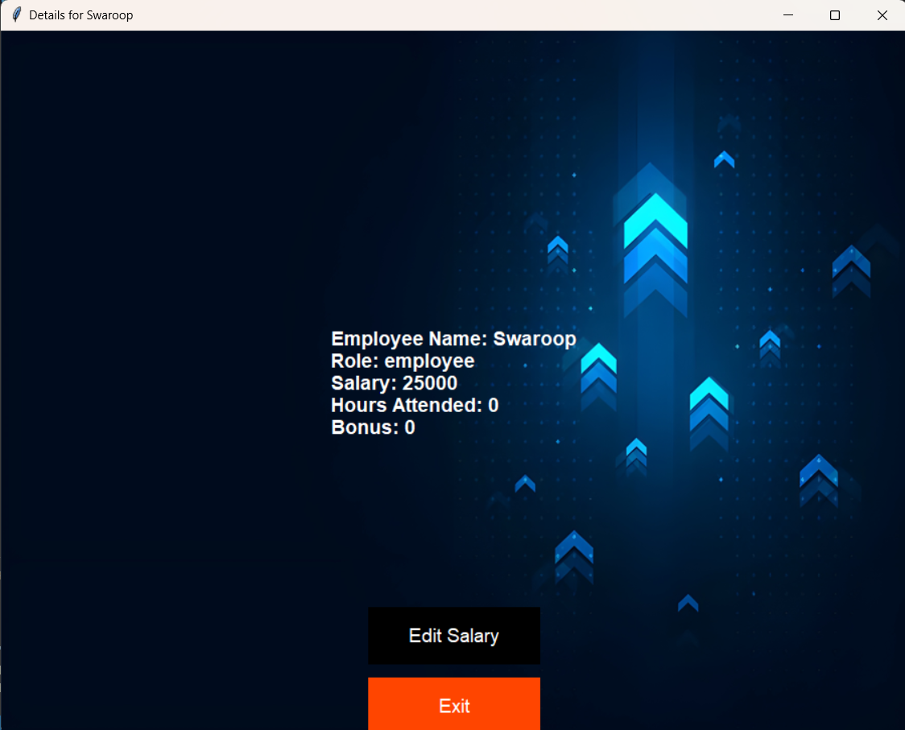
Shows the updated salary in the details window.
Figure 12

Slide 29
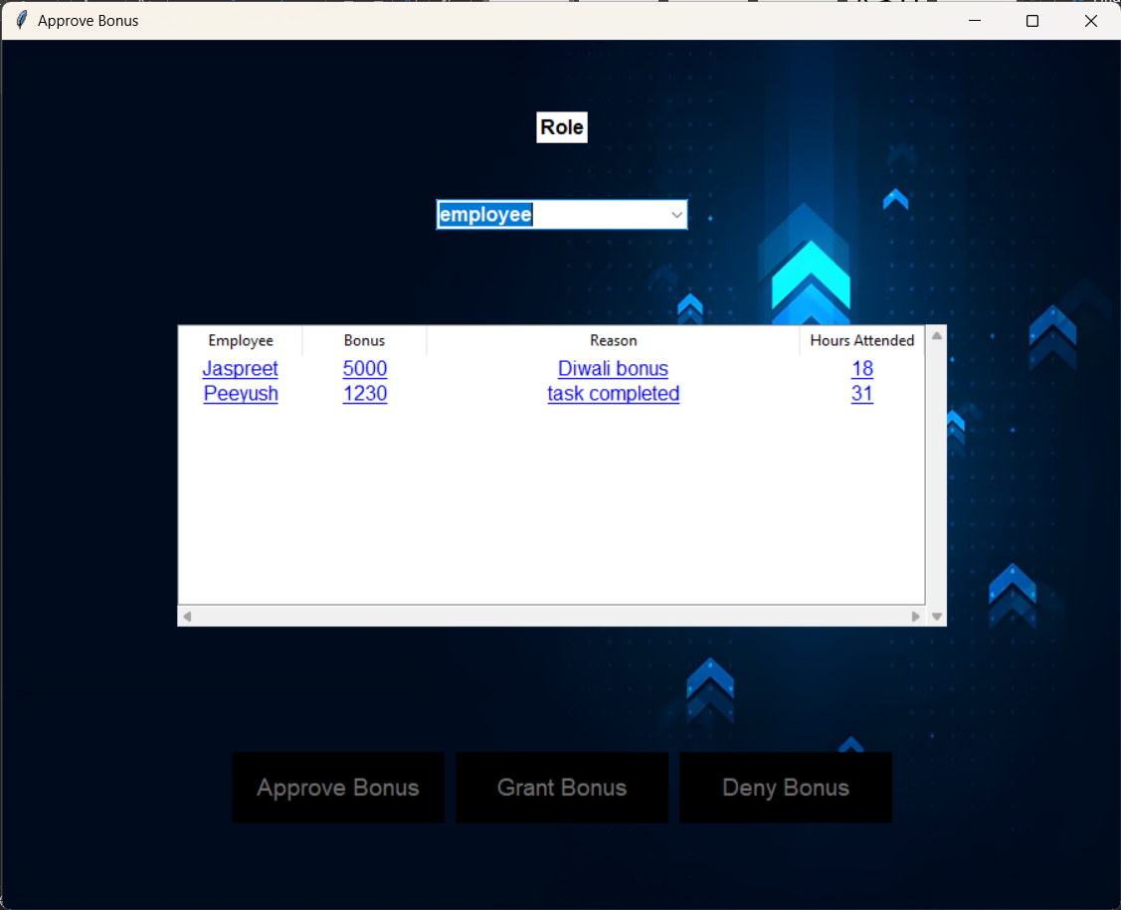
Approve Bonus: -
The Employee bonus is requested by the Manager and has to be approved by the HR, giving the HR two options to either approve or deny the request.
Figure 13

Slide 30
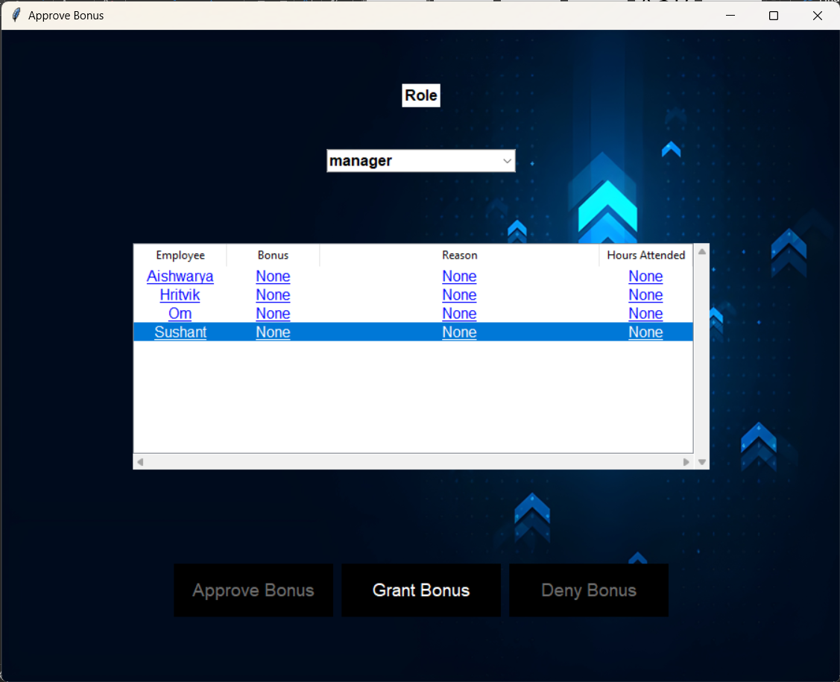
For Manager level the HR directly grants bonus on their discretion, therefore the grant bonus option is available which when clicked opens a new window (figure 15).
Figure 14

Slide 31
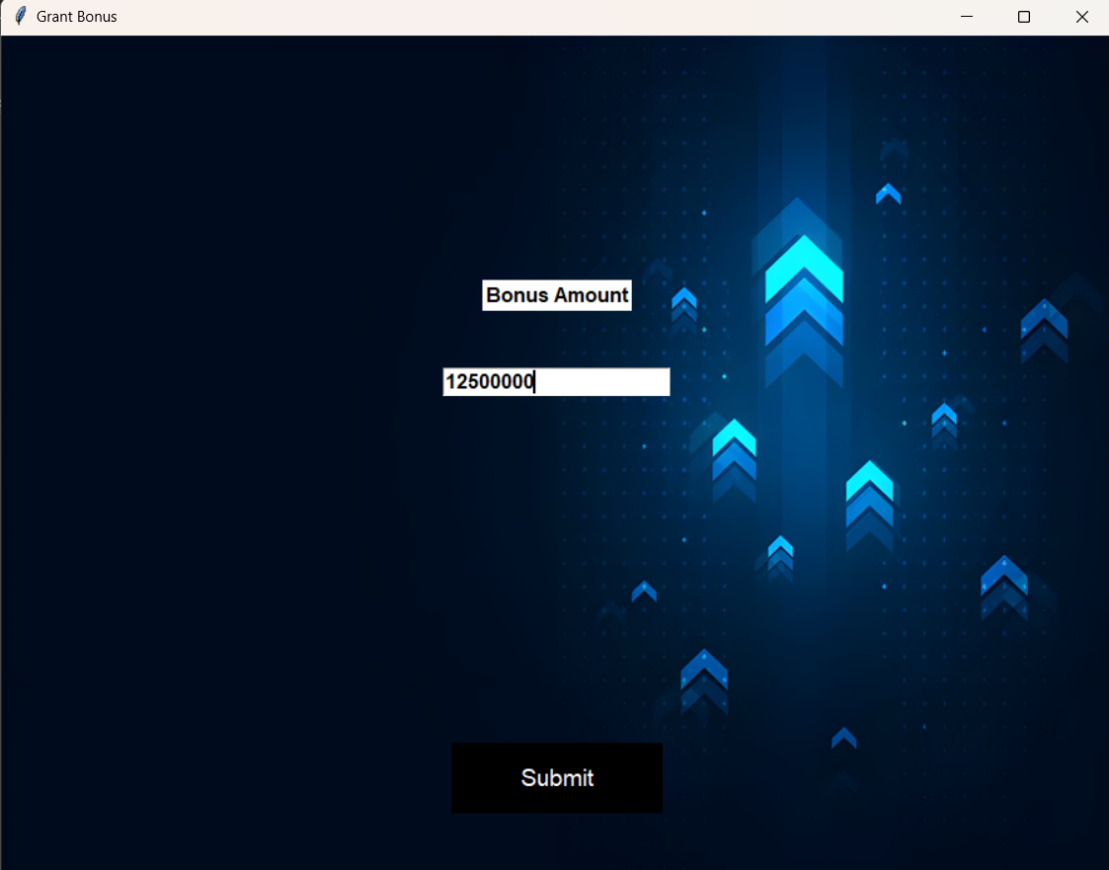
Gives the HR the input box to input the amount of bonus that should be provided the specified Manager, on clicking the submit button is shown.
Figure 15

Slide 32
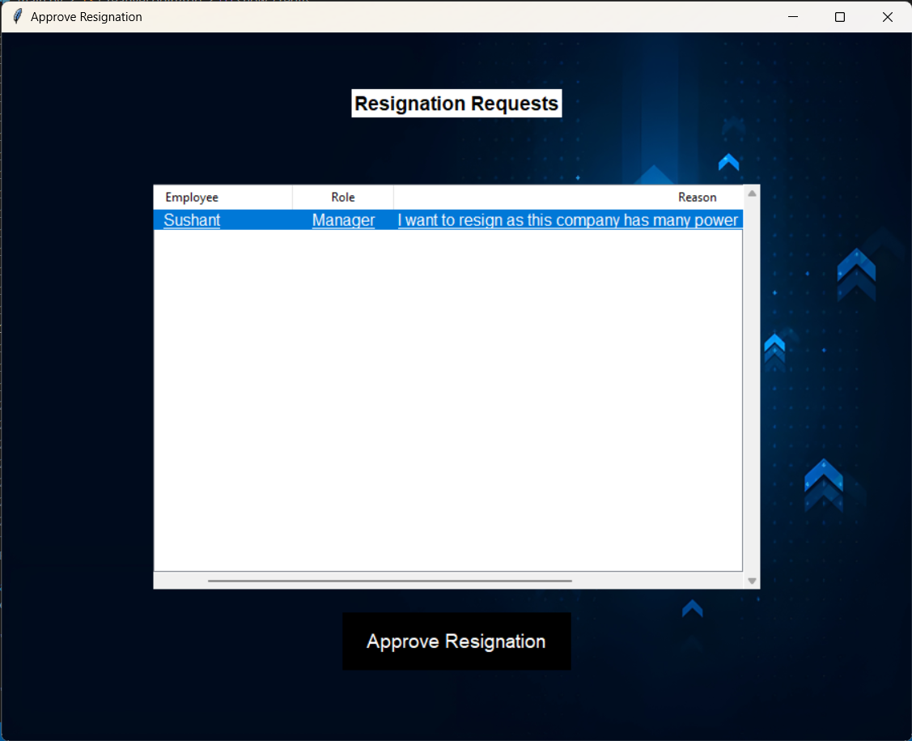
Approve Resignation: -
Upon clicking the Approve resignation button a new window shows up with the list of employees whose resignation approval is pending, upon clicking the respective employee the approve button highlights itself which can then be clicked to approve the resignation.
Figure 16

Slide 33
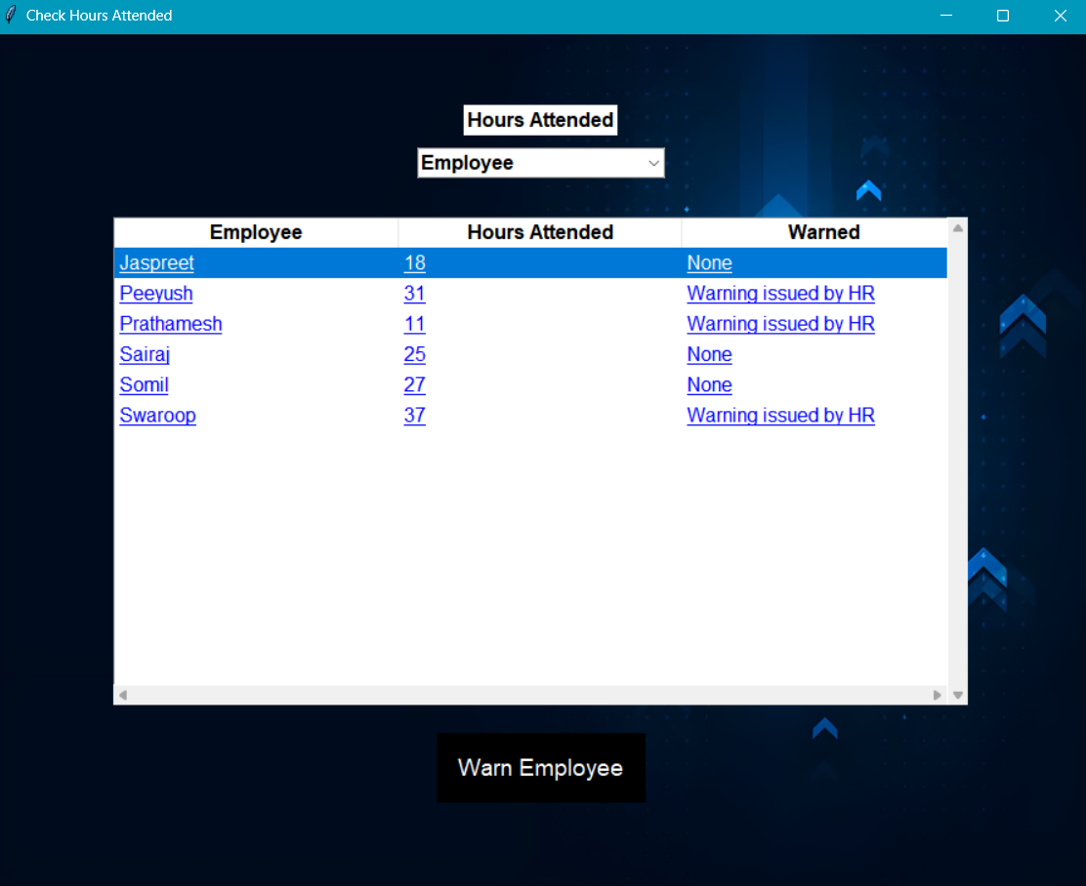
Check Hours Attended: -
This window represents the following employee list and their hours of attendance. Here we can observe the employees and manager as well for the hour of attendance. The HR can also issue a warning to the employee or manager regarding the respective matter directly to the particular person.
Figure 17

Slide 34
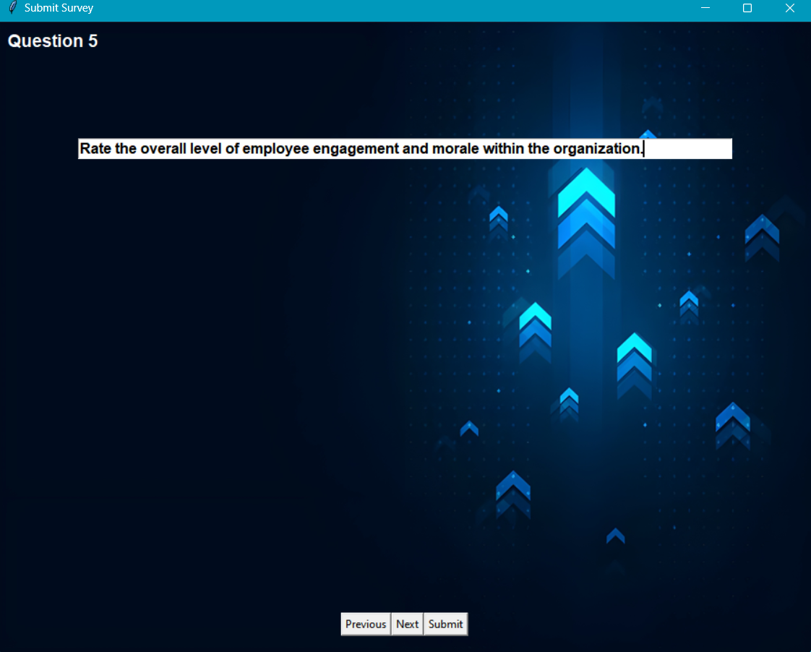
Create a Survey: -
Shown is a question of a new survey along with the previous next and submit buttons to move between the questions and to assign the survey for the employees to fill it. This gives the freedom to the HR to make a survey from 1 question all the way to 22 questions and the system will dynamically make the survey with the questions.
Figure 18

Slide 35
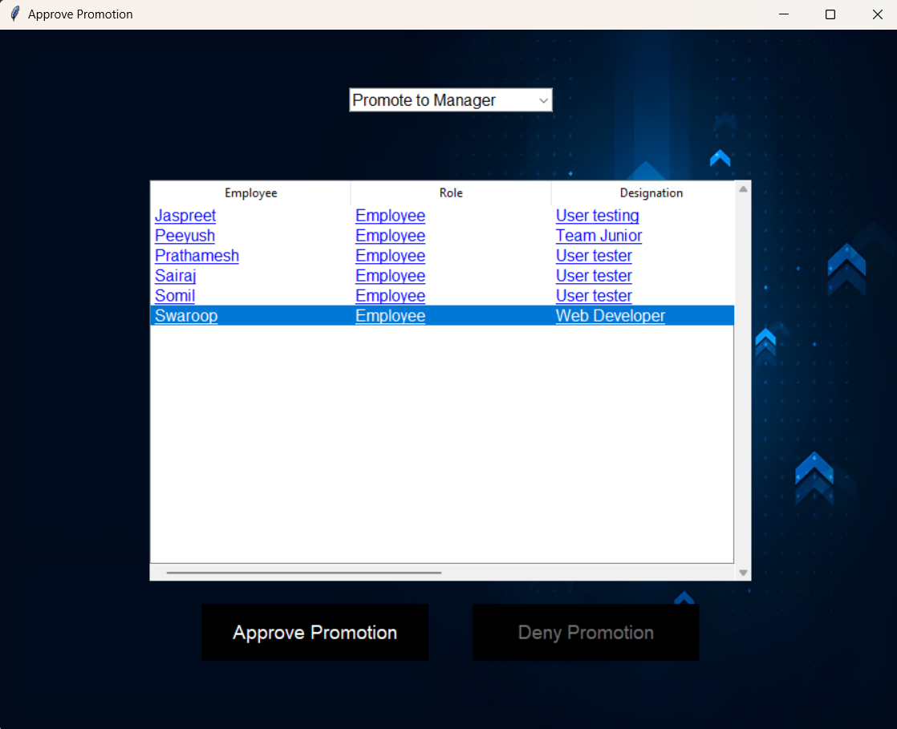
Approve for promotion: -
Upon clicking the Approve promotion button a new window shows up with the list of employees whose promotion approval is pending, upon clicking the respective employee the approve button highlights itself which can then be clicked to approve the promotion.
Figure 19

Slide 36
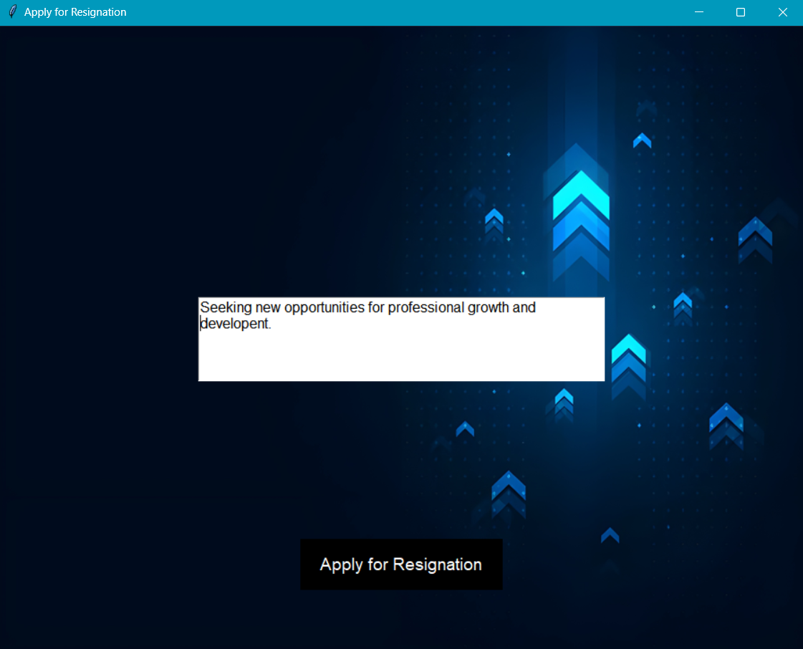
Apply for Resignation: -
The window represents an application with which the HR can write a resignation with respect to whatever specific reasons he feels right.
Figure 20

Slide 37
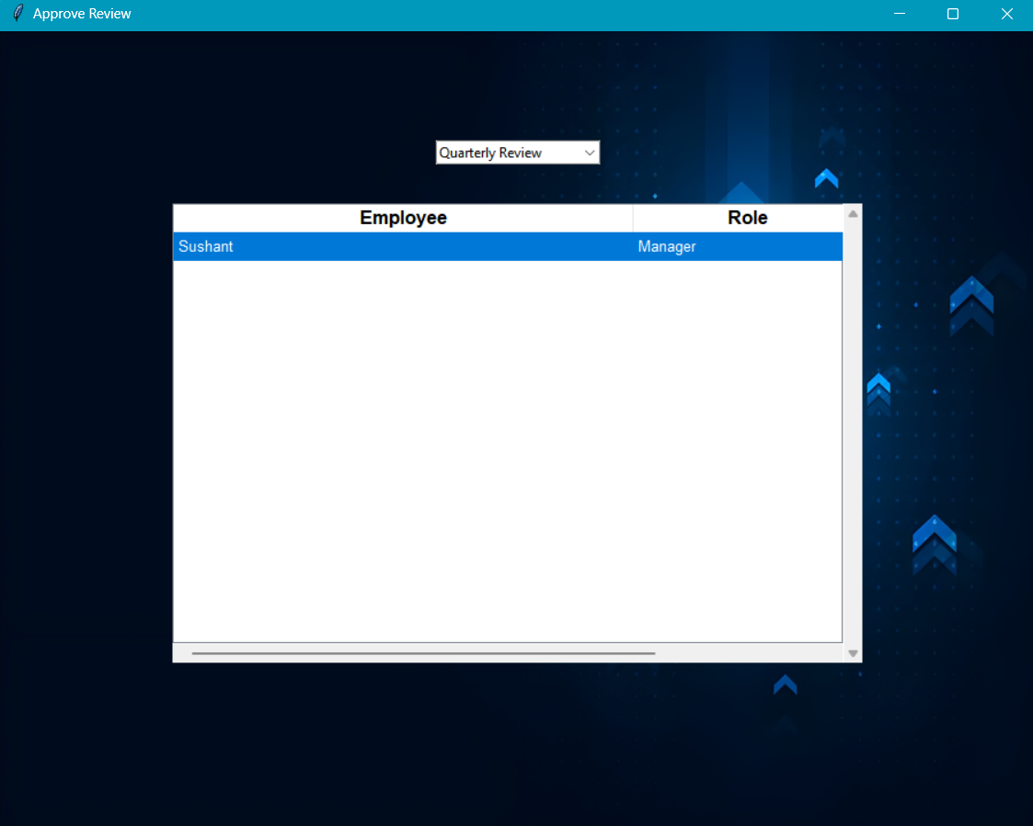
Approve Review: -
Upon clicking the Approve Review the HR is able to view a menu which has an option of reviewing results with respect to Quarterly or Annual review.
Figure 21

Slide 38
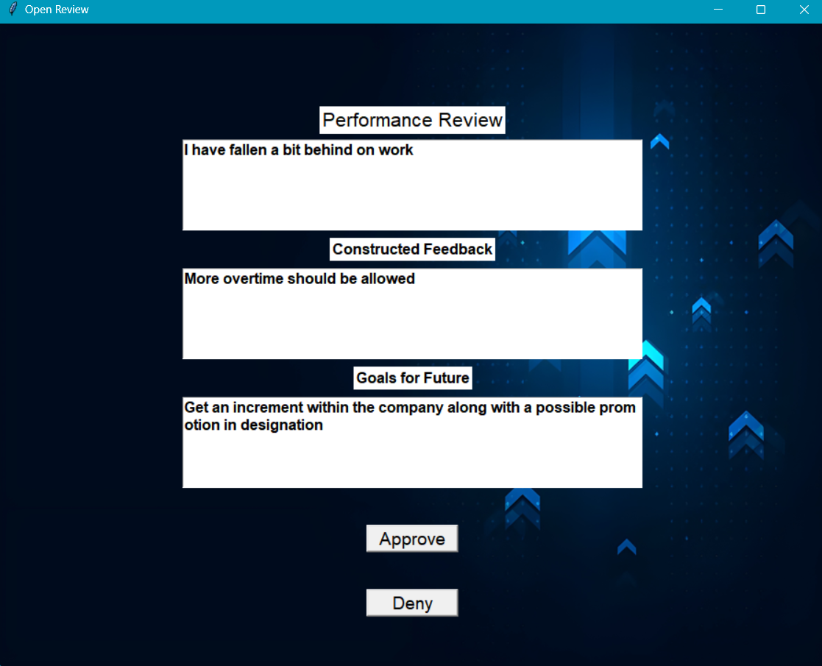
This window represents the review of the manager. Also, with an option to approve or deny the request which is then send back to the same profile user. This makes communication more understanding and clearer.
Figure 22

Slide 39
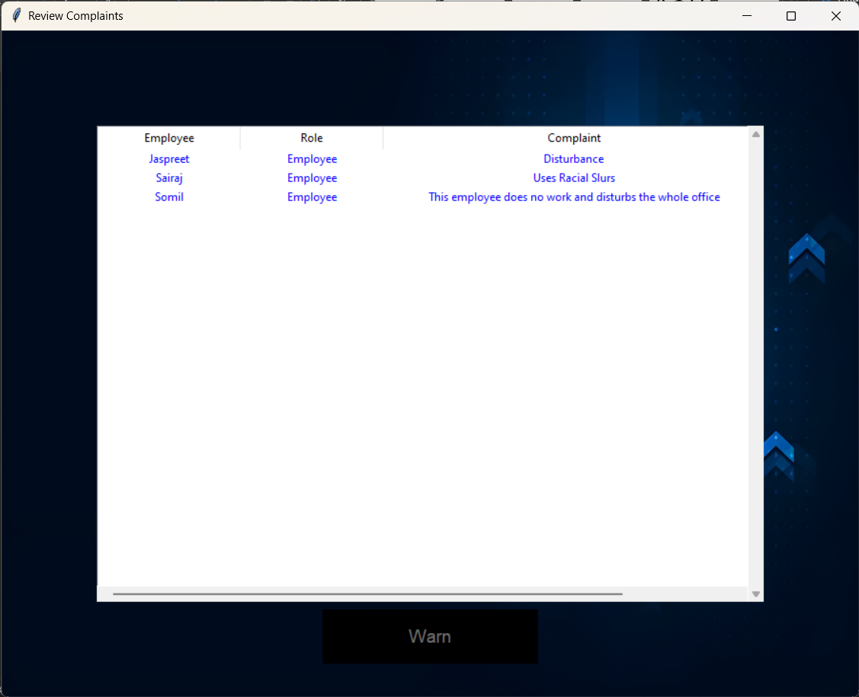
Review Complaint: -
HR role can review the complaints regarding the employee which only be viewed by HR are observed. The details of the employee as well as the role of the employee is shown in the respective figure. With this the HR can directly give a warning statement to the employee regarding the matter personally.
Figure 23

Slide 40
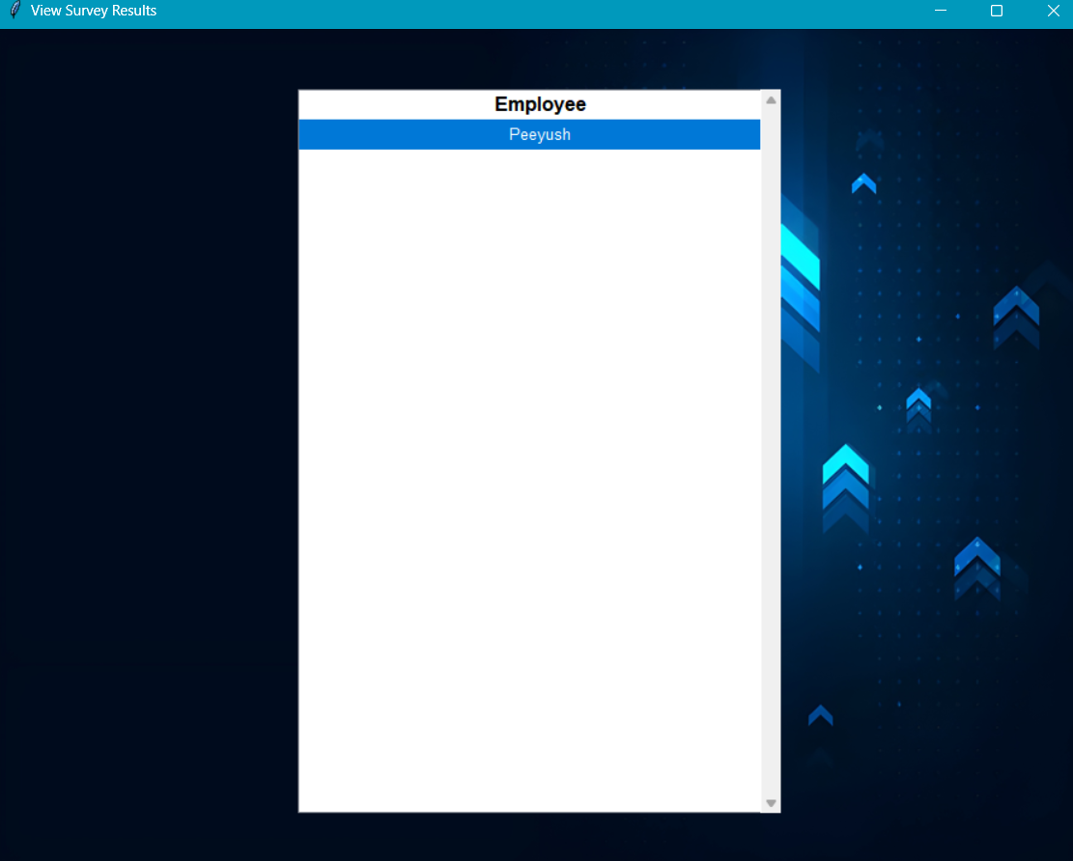
View survey result: -
The window represents the results of the survey completed from every employee which provides the information to the HR regarding any issues directly. This helps the HR to get an insight of the environment problems faced by the employees. To view the answers set by the employee, the HR can click on the profile which will open a new window (figure 25).
Figure 24

Slide 41
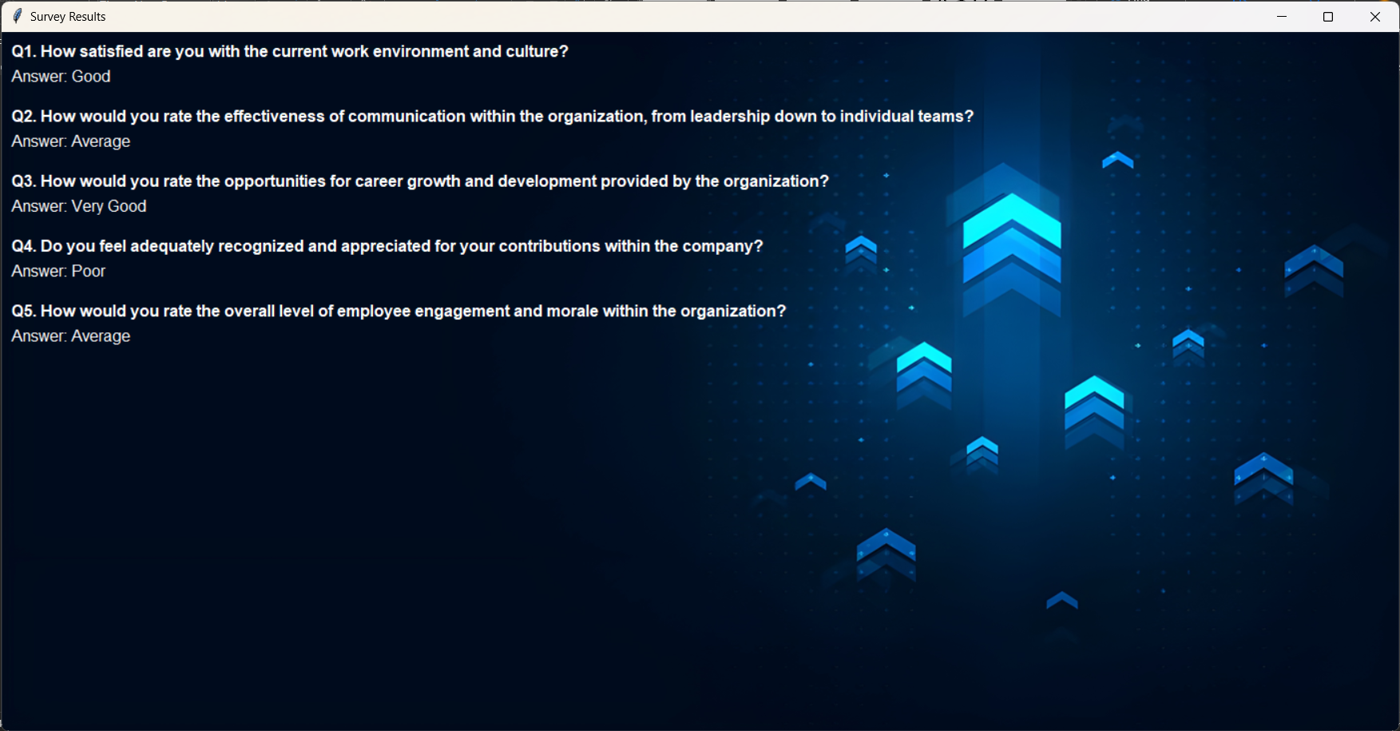
Upon clicking on a particular profile which has submitted the survey answers, the HR can review the answers shown along with the questions.
Figure 25

Slide 42
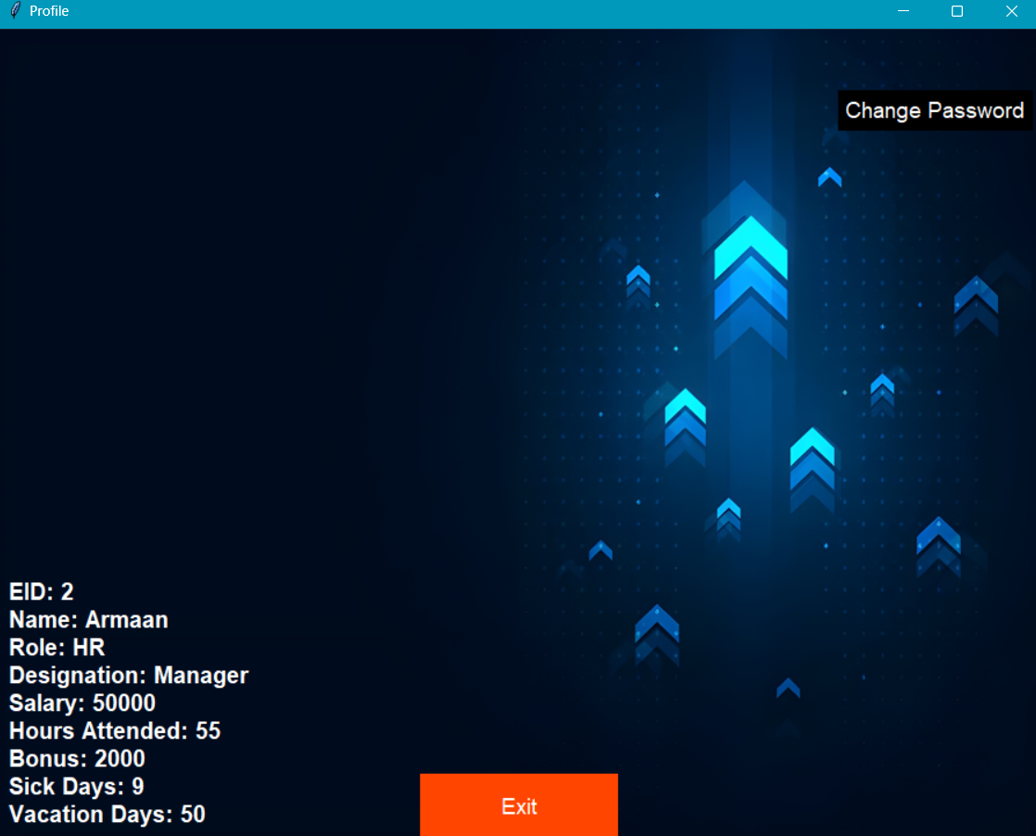
Profile For HR: -
This Profile screen represents the details for the HR which shows the Name, EID, Role, Designation, Salary, Hours Attended, Bonus and Sick days leave/ Vacation days leave. The user is also able to change its password through this screen.
Figure 26

Slide 43
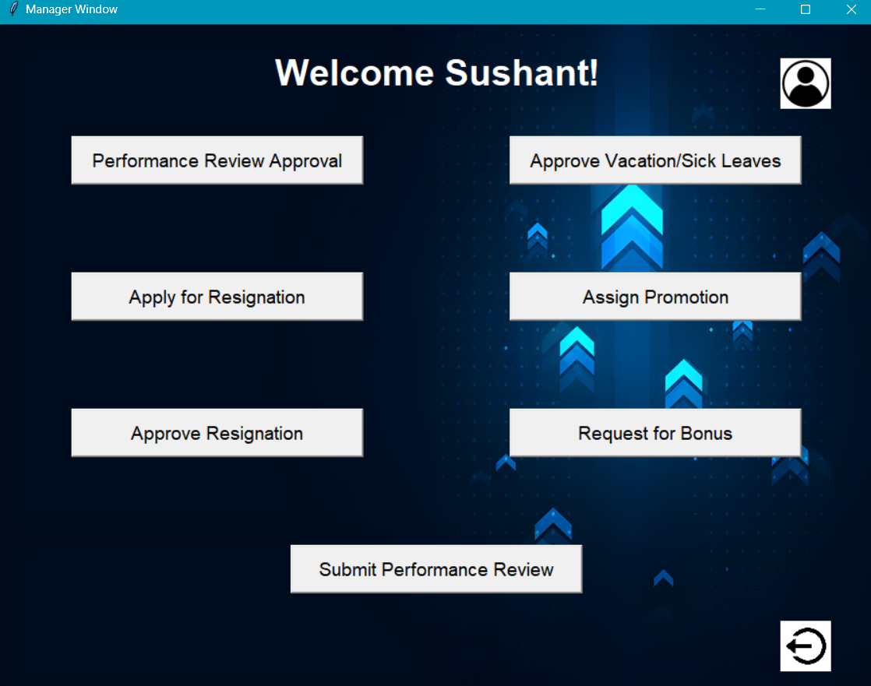
Manager Window:
The window that is shown to the user who logs in at the manager level, the user has the options to approve performance reviews (figure 28), approve vacation/sick leaves (figure 30), apply for self resignation (figure 33), assign promotion for an employee (figure 34), approve an specific employee’s resignation request (figure 36), request bonus for an employee (figure 37) and submit their own performance review for the HR to check (figure 39). This window also has buttons to view the profile (figure 40) and to logout from the login which will take the user back to the main login screen (figure 1).
Figure 27

Slide 44
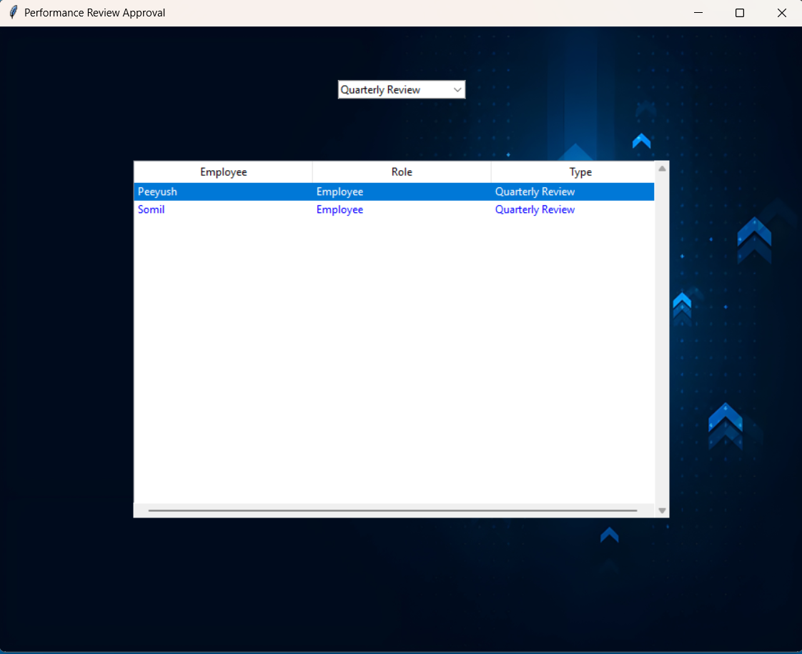
Performance Review Approval: -
Opens a new window when the approve performance review button is clicked, this displays the list of employees who have filled their quarterly and annual reports separately, clicking each employee’s name will give the information they have filled, that performance review can then be approved or denied by the manager.
Figure 28

Slide 45
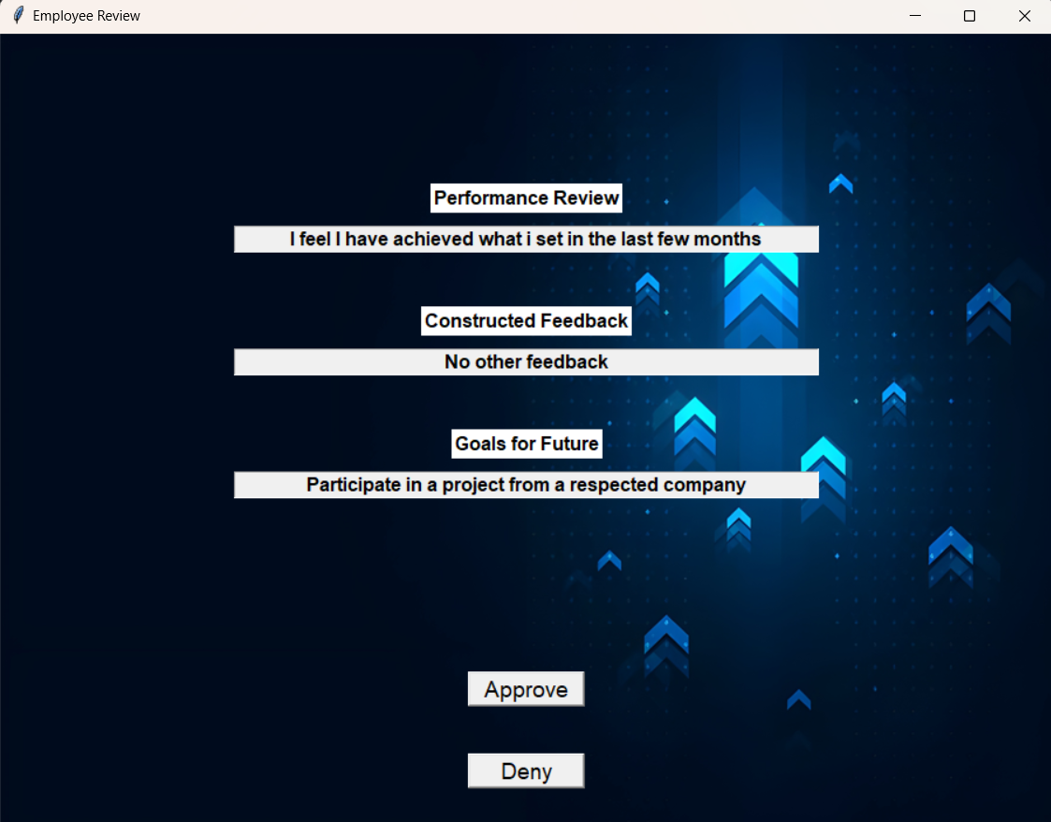
Shows the details of the performance review filled in by the employee along with approve and deny buttons for the performance review.
Figure 29

Slide 46
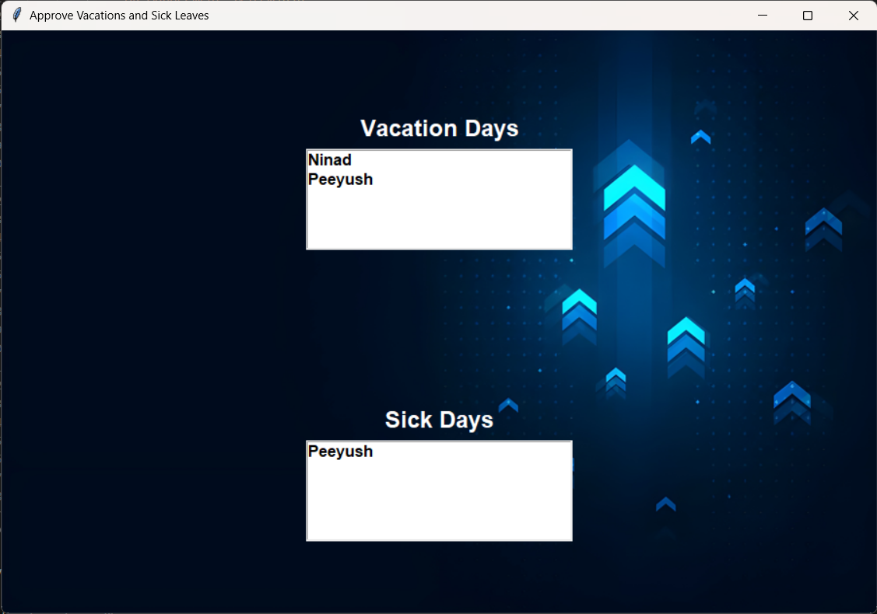
Approve Vacations and Sick Leaves: -
The list of employees whose vacation and sick leave approvals are still pending will be shown in separate list here, the Manager can then click on each user’s name and view the details filled in.
Details for vacations days (figure 31) and sick days (figure 32) are shown separately to reduce confusion for the Manager.
Figure 30

Slide 47
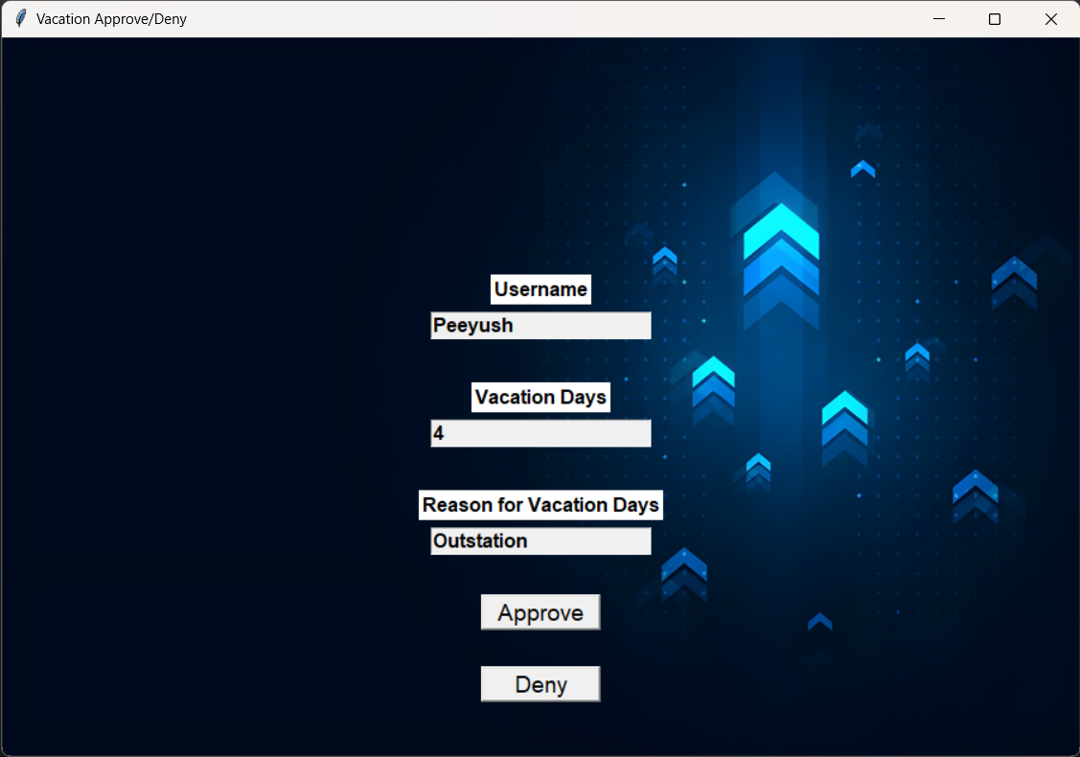
Shows the number of vacation days requested along with buttons to the approve or deny the request by the employee.
Figure 31

Slide 48
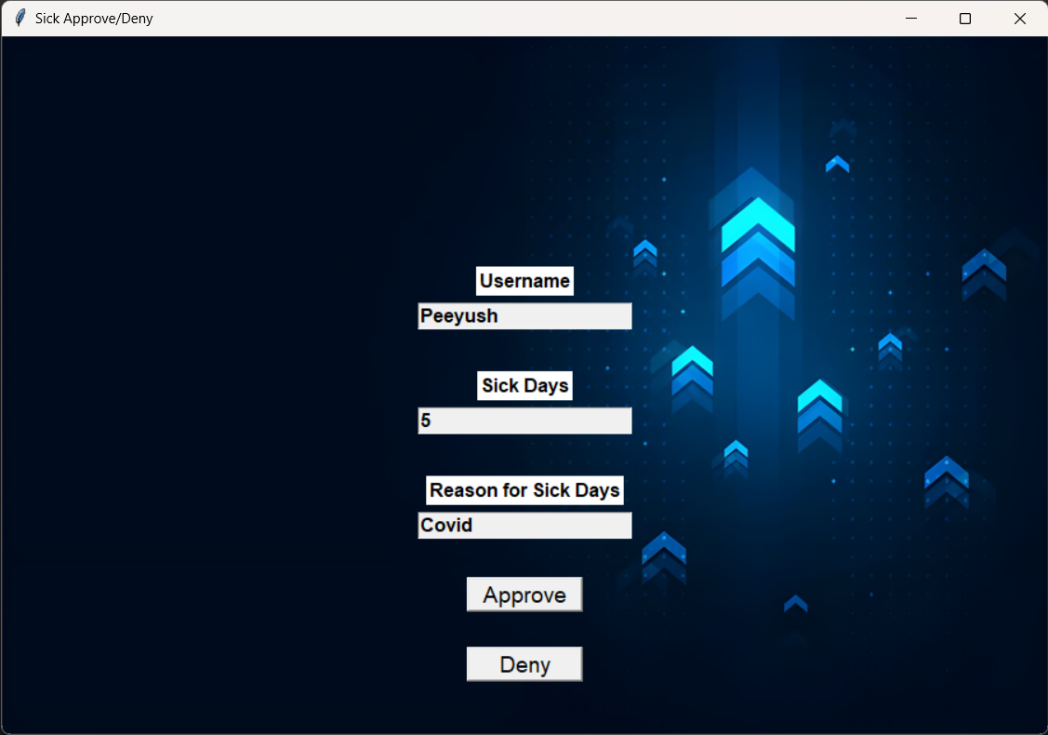
Shows the number of sick days requested along with buttons to the approve or deny the request by the employee.
Figure 32

Slide 49
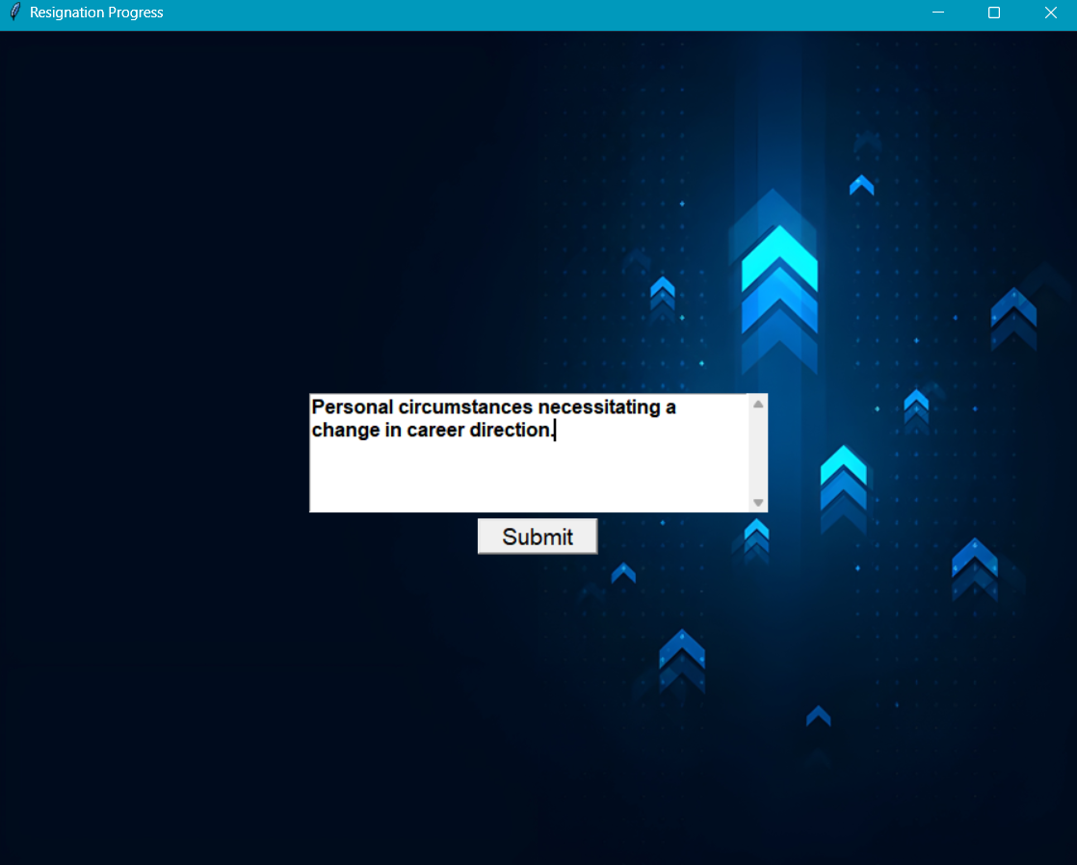
Apply for resignation: -
Upon clicking apply for resignation this window will give you a textbox which when submitted will send your application for resignation.
Figure 33

Slide 50
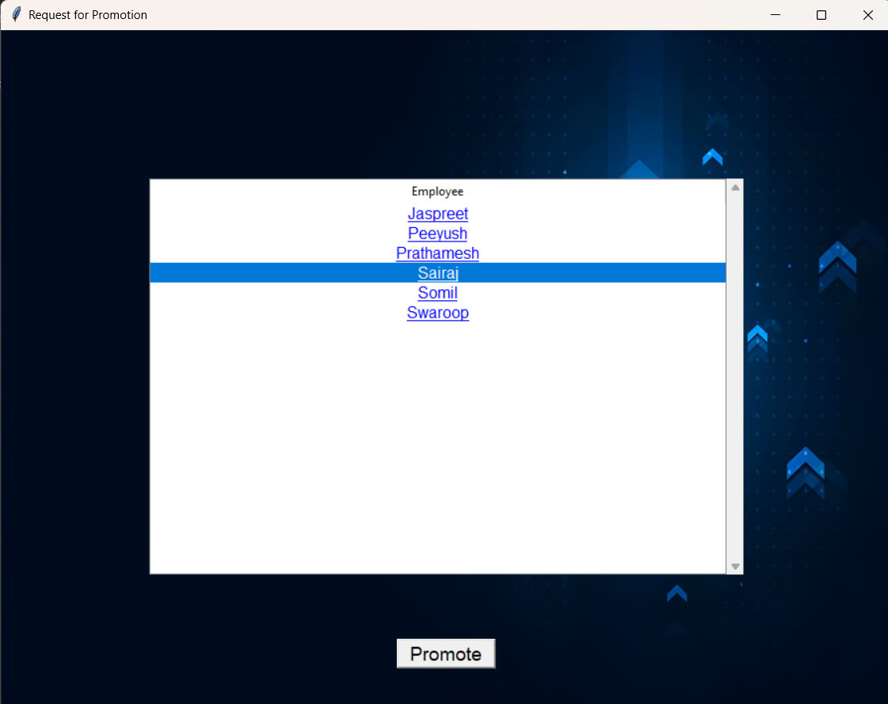
Assign for promotion: -
Upon clicking the Approve promotion button a new window shows up with the list of employees whose promotion approval is pending, upon clicking the respective employee the promote button highlights itself which can then be clicked to approve the promotion.
Figure 34

Slide 51
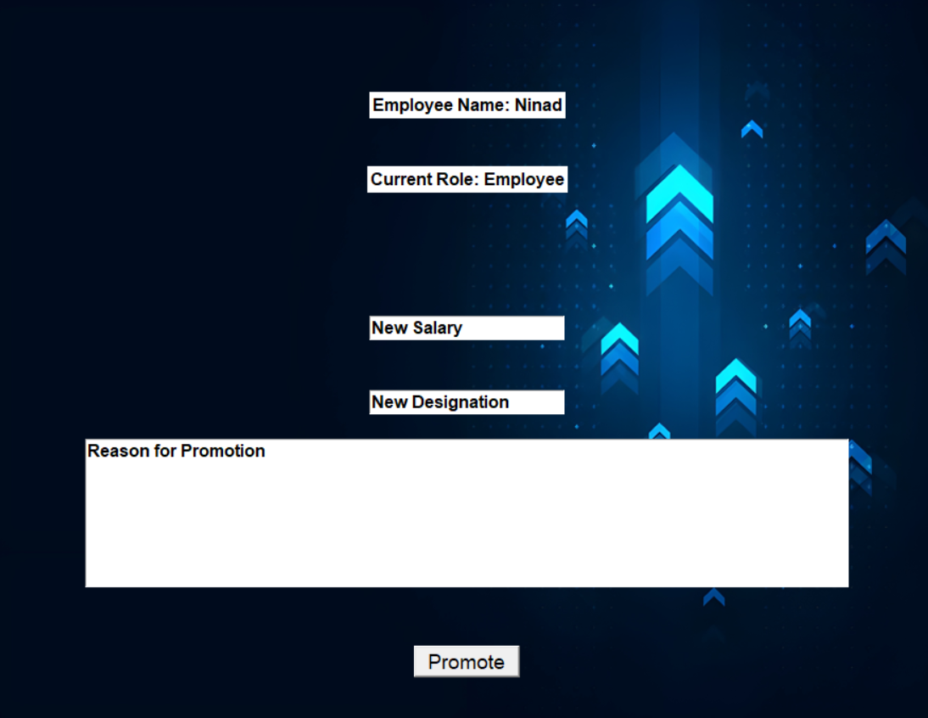
In this figure with the request of promotion for the employee, the updated salary needs to be entered along with the new designation after which the request is sent to the HR for final approval after which the updated details are put into effect.
Figure 35

Slide 52
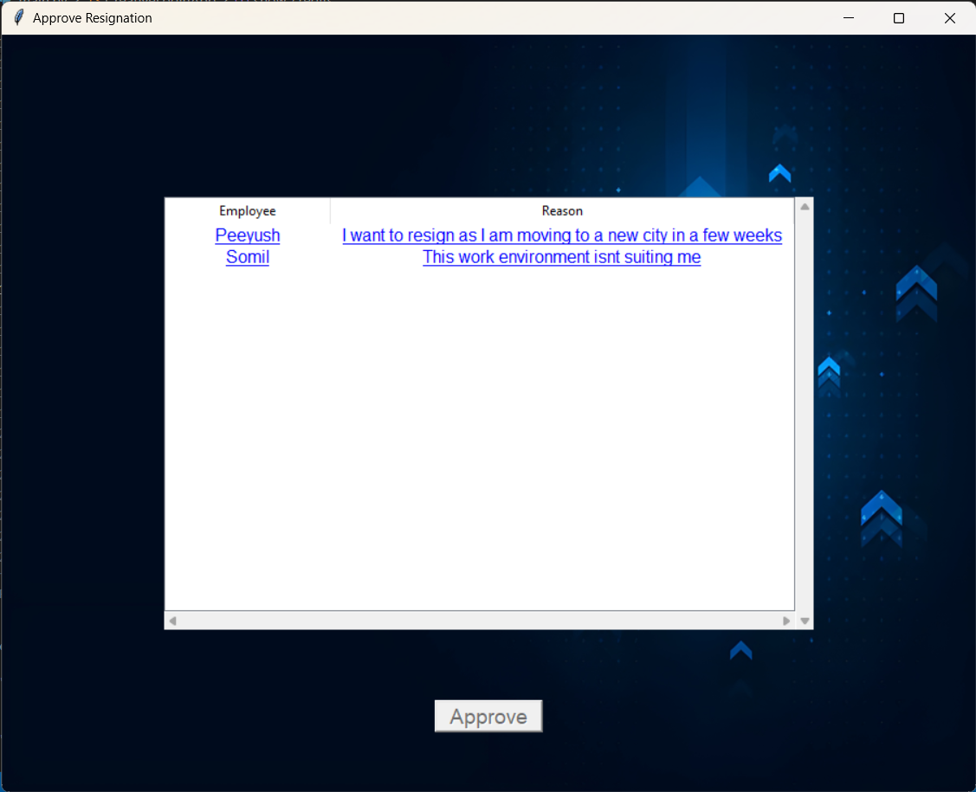
Approve resignation: -
Upon clicking the Approve resignation button a new window shows up with the list of employees whose resignation approval is pending, upon clicking the respective employee the approve button highlights itself which can then be clicked to approve the resignation.
Figure 36

Slide 53
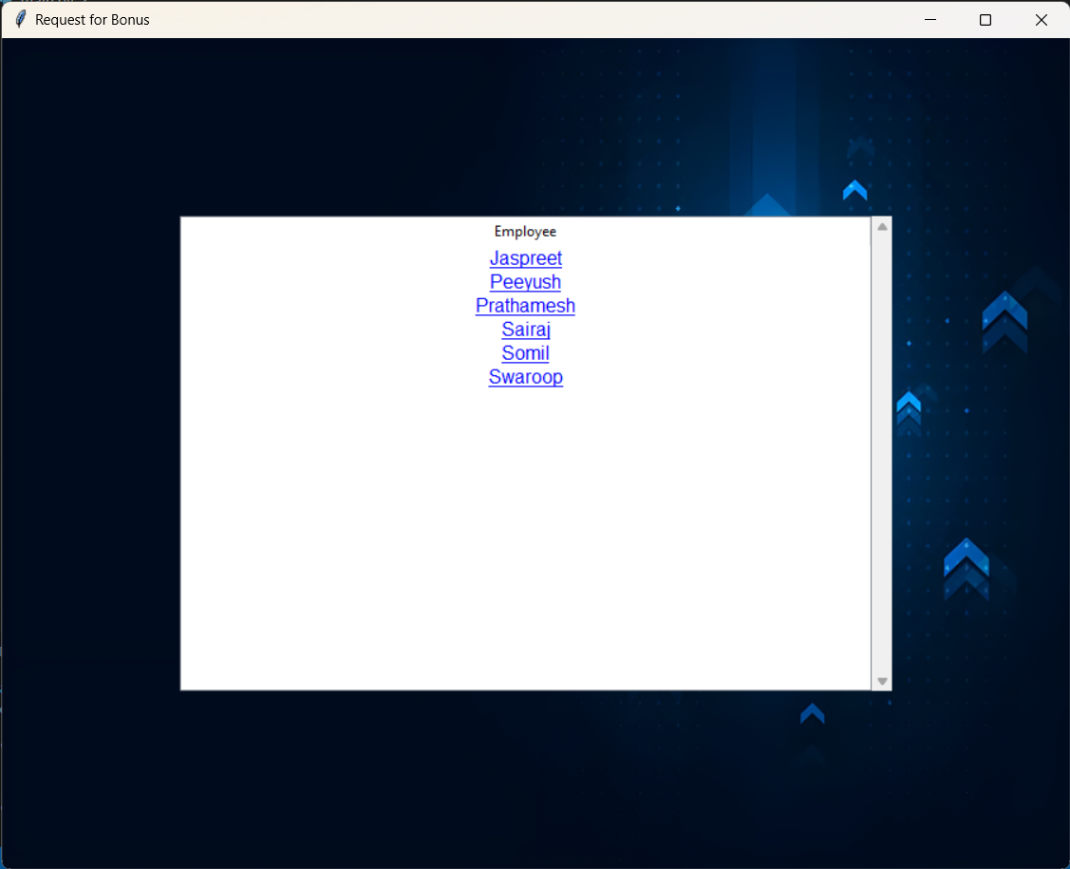
Request for Bonus: -
When the Request for Bonus button is clicked, this new window is shown to the Manager, from where the they can choose which employee deserves the bonus and click on that employee’s login. Clicking on a particular login will open a new window (figure 38).
Figure 37

Slide 54
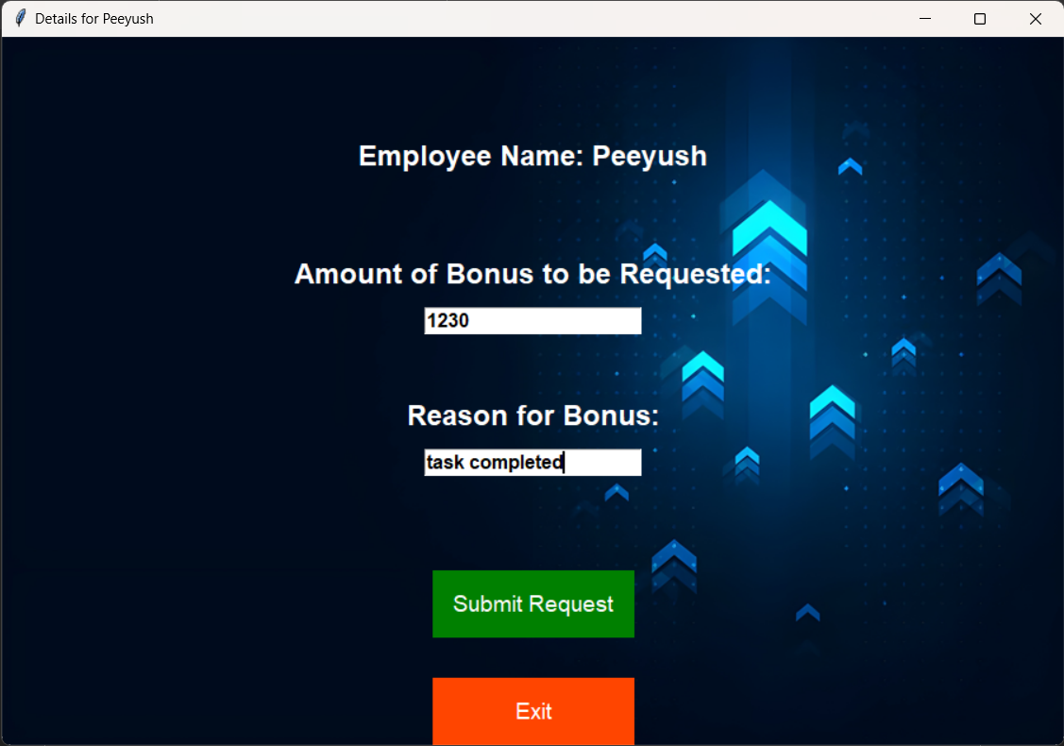
This new window gives the option for the amount of bonus to be requested by the manager for the employee along with the reason for this. There are also two buttons to submit the request or exit from that window
Figure 38

Slide 55
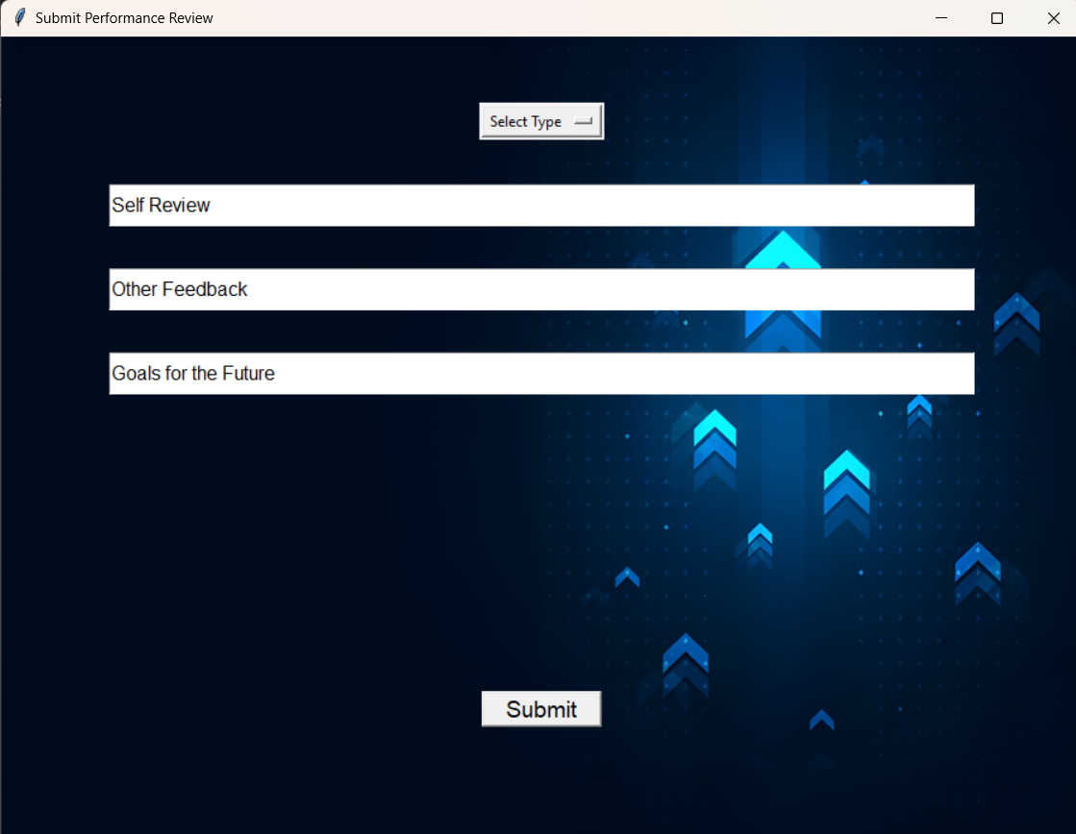
Submit Performance Review: -
User can provide reviews regarding any kind of concern. This will help the HR to clear the vision and the expectation of the Manager future growth and development goals. Plus, the manager can provide feedback about others regarding there positive or negative concerns respectively.
Figure 39

Slide 56
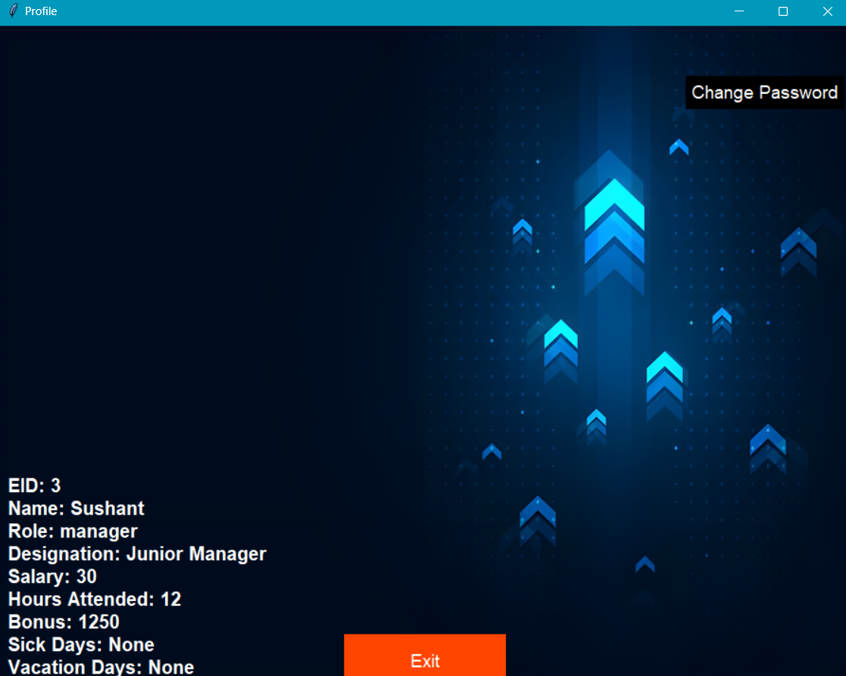
Profile Window for manager: -
This Profile screen represents the details for the Manager which shows the Name, EID, Role, Designation, Salary, Hours Attended, Bonus and Sick days leave/ Vacation days leave. The user is also able to change its password through this screen
Figure 40

Slide 57
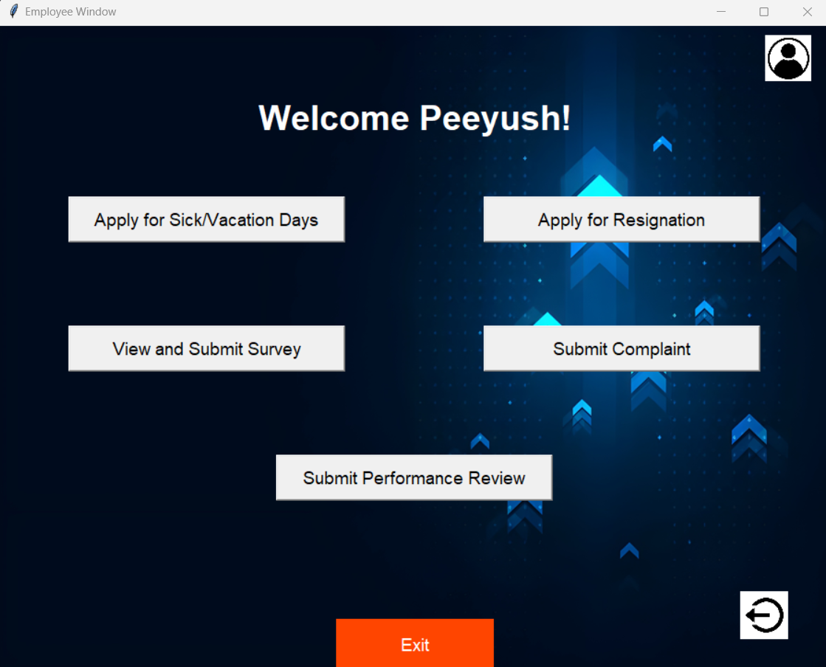
Employee Window: -
The window shown to the employee role and permission level, it consists of options to Apply for sick/vacation days (figure 42), apply for resignation (figure 43), view and submit surveys created by the HR (figure 44), submit complaints (figure 45) and submit their own performance review (figure 46). Like other windows this window also includes the profile button to view the profile details (figure 47) and a logout button that will take the user directly to the main login page (figure 1).
Figure 41

Slide 58
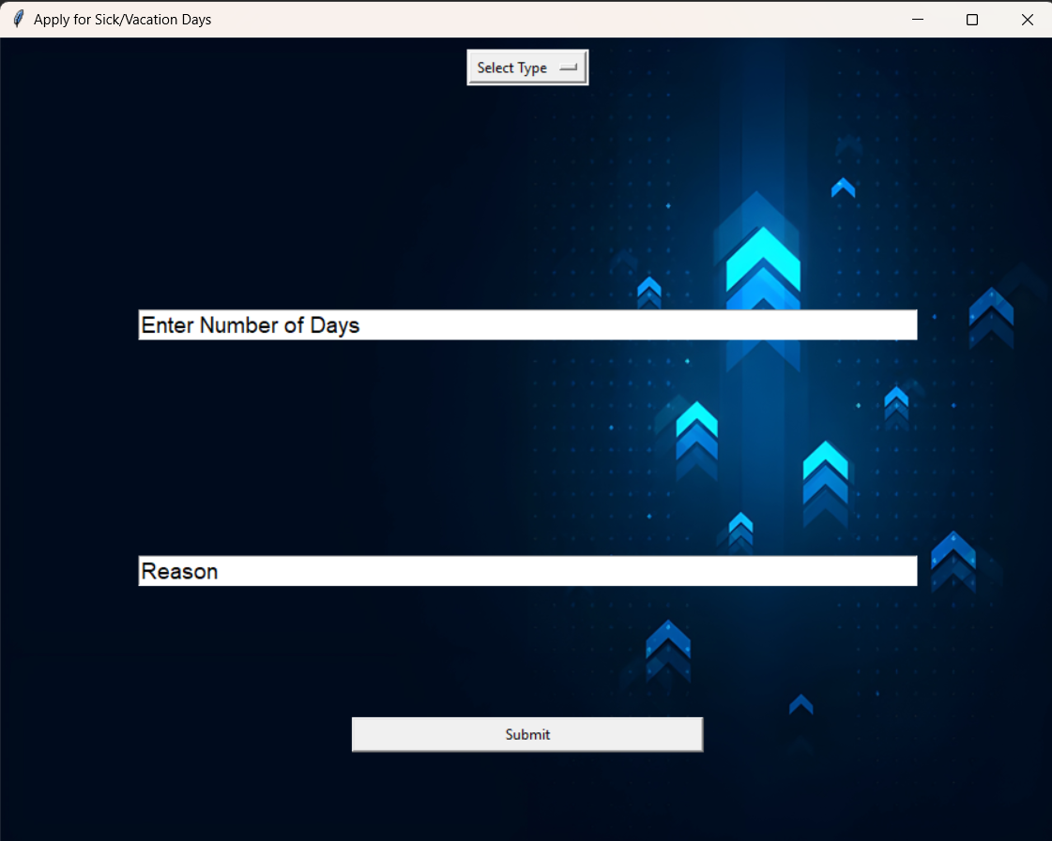
Apply For Sick/Vacation Days: -
This window is opened when the employee clicks on the Apply for Sick/Vacation days button, it gives the employee the options to choose between the sick and vacation days request along with the number of days to be requested and the reason for the request.
Figure 42

Slide 59
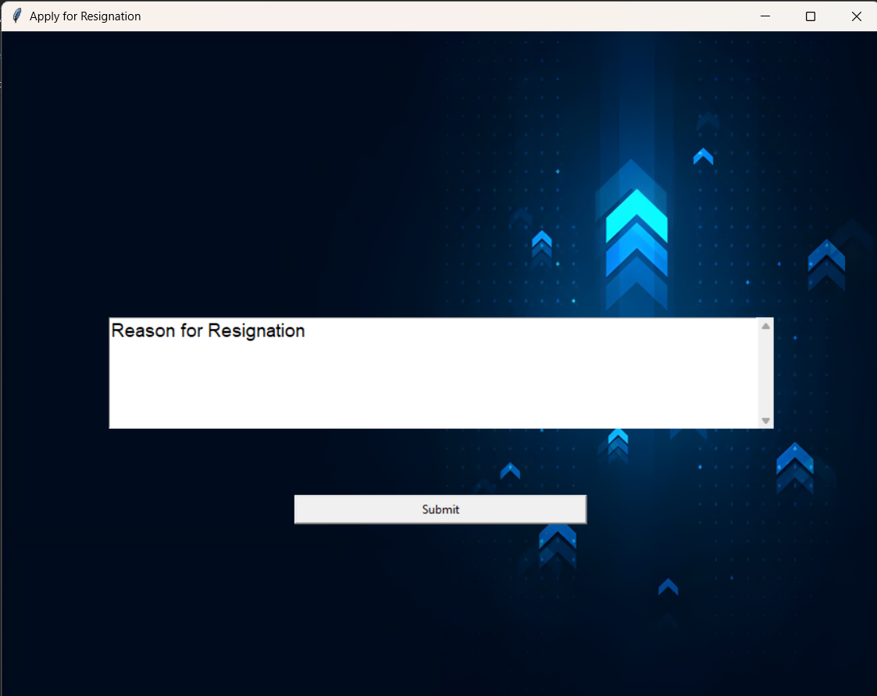
Apply for Resignation: -
The window shown when the user clicks on the apple for resignation button, which ask the user for the to apply for resignation (minimum 2 weeks’ notice) along with the reason for the resignation and a submit button to submit the request.
Figure 43

Slide 60
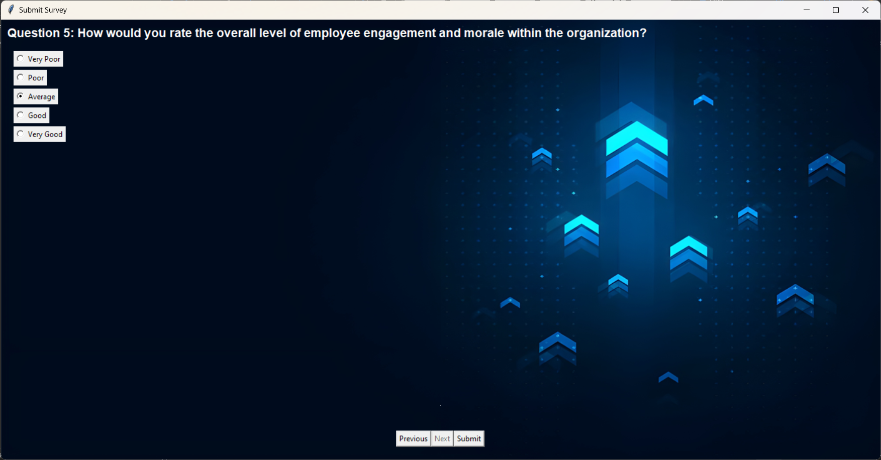
View and Submit Survey: -
The window shown when the user clicks on the submit survey button to fill the survey set by the HR for the employees. The questions are displayed along with the question number and the radio buttons for the options, at the bottom of the window there are 3 more buttons for previous, next and submit.
Figure 44

Slide 61
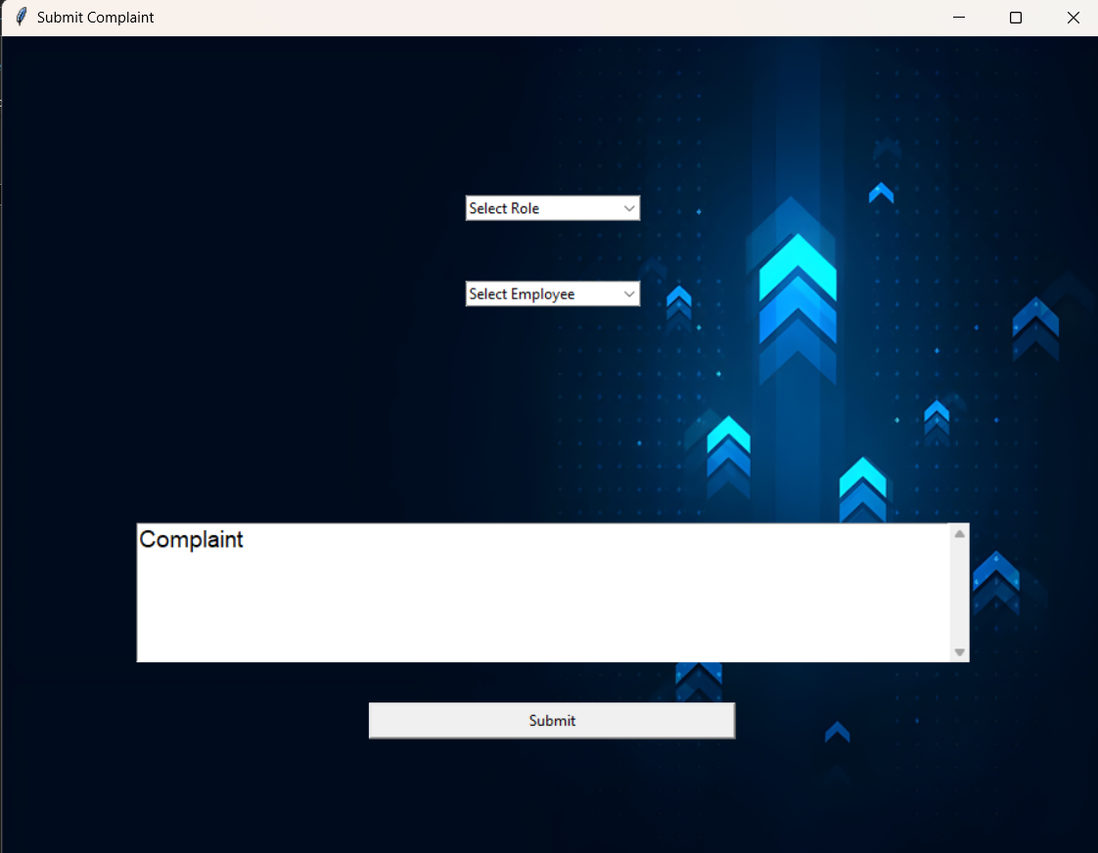
Submit Complaint: -
When an employee clicks on the submit complaint button this window is created which gives 2 input boxes for the name of the employee along with the reason for the complaint, after the two input boxes there is a submit button.
Figure 45

Slide 62

Submit Performance Review: -
When the Submit performance review button is clicked this window is shown to the user which gives the option to select from quarterly review and annual review, along with 3 input boxes for their self-review, feedback for the company and future self-goals, below the input boxes is a submit button.
Figure 46

Slide 63

Profile For Employee: -
This Profile screen represents the details for the Employee which shows the Name, EID, Role, Designation, Salary, Hours Attended, Bonus and Sick days leave/ Vacation days leave. The user is also able to change its password through this screen.
Figure 47

Slide 64

DATABASE :
This is the complete structure of Database of Enhanced E-HR Management System which is made in Firebase Realtime Database. Firebase Realtime Database is a NoSQL database that stores data as JSON objects. Unlike relational databases, Firebase Realtime Database does not use tables with rows and columns. Instead, it uses a hierarchical structure of keys and values. The “emp_id” variable determines the employee-id of any new logins created and then is automatically incremented so all the employees have a different employee-id.
Figure 48

Slide 65




This is the part of the database that contains the separate logins for each Admin, HR, Manager and Employee. For each hierarchal set of logins there is a separate category and set in which the logins are stored , this helps in efficiency while retrieving data from the database and helps in maintaining the data.
Figure 49
Figure 50
Figure 51
Figure 52

Slide 66

The detailed structure of the data of an Admin profile. It consist of the emp_id, password and the role.
Figure 53

Slide 67

Detailed structure of the HR profile, it consist of all the variables needed for the working of the program.
Figure 54

Slide 68

Detailed structure of the Manager profile, it consist of all the variables needed for the working of the program.
Figure 55

Slide 69




Figure 56
Figure 57
Detailed structure of the Employee profile, it consist of all the variables needed for the working of the program.
Figure 58
Figure 59

Slide 70

The part of the database that holds the structure and questions for the survey which is pushed by the HR which is to be filled by the employees.
Figure 60

Slide 71
References
1. Sohail Ahmed, XingKE ,“Human Resource Management: Employees Career Development Impact on Organizational Performance” , Yunnan, China 2016
2. Hewage H.A.S.S, Hettiarachchi K.U, Jayarathna K.M.J.B, Hasintha K.P.C., A. N. Senarathne, J. Wijekoon, “Smart Human Resource Management System to Maximize Productivity” ,Malabe Sri Lanka , 2020
3. Lina Zhang ,“Research on the Application of Human Resources Information Management System under Computer Big iData Technology” , Dalian China , January 2023
4. Yawen Mi, Enduo Gao ,“Design of Human Resource Management System Based on Java EE”, Shanghai China, June 2023
5. D Chavan, A Kiran ,“Dot Diffusion Block Truncation Coding For Satellite Image Retrieval” ,International journal of Computer Applications 124 (4), 24-29
6. D Chavan ,KA Bhandari , “A New Block Truncation Coding (NBTC) For Satellite Image Retrieval Using Dot Diffusion”, IJSER6 (ISSN2229-5518), 9
7. Shayista Majeed , Sabzar Ahmad Peerzadah and Sabiya Mufti, “Electronic Human Resource Management: Need of the Hour", University of Kashmir, July 2020
The Github Repository of this Project with the Source code, Project Report and a copy of this PPT can be found at: https://github.com/ChampionSamay1644/Sem_4_Mini_Project

Slide 72



Certificates for the Research Paper :

Slide 73
Thank You!!!

